Slide 1
Chapter 13
Dialogue Replaces Monologue: Heterotypic Interactions and the Biology of Angiogenesis（血管形成）
Dec 15, 2023

Slide 2
Outline of this lecture
1, Tumor associated stromal cells;
Tumor stroma, Wound healing, epithelial– mesenchymal transition(EMT) & MET,
Capillary leakiness, Macrophage.
2, Angiogenesis;
History, Key factors, Therapy.
Notes:
肿瘤组织里面未必都是肿瘤细胞！

Slide 3
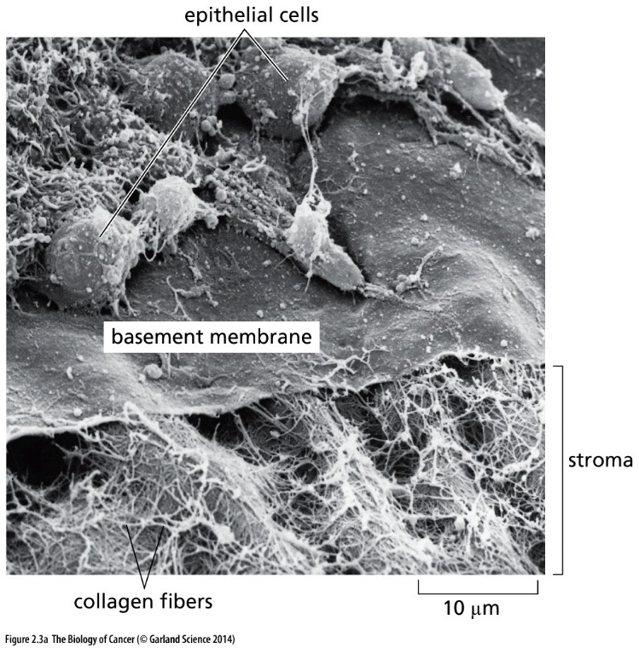
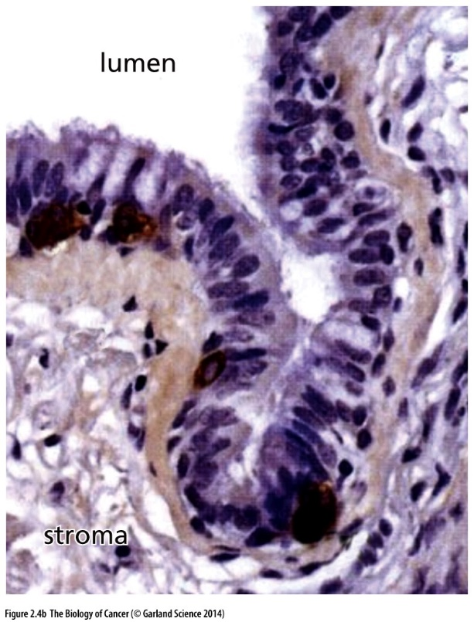
Epithelial vs stromal cell
Figure 2.3 Basement membranes(基底膜)
Figure 2.4 Architecture of epithelial tissues
Carcinoma: epithelial origin

Slide 4
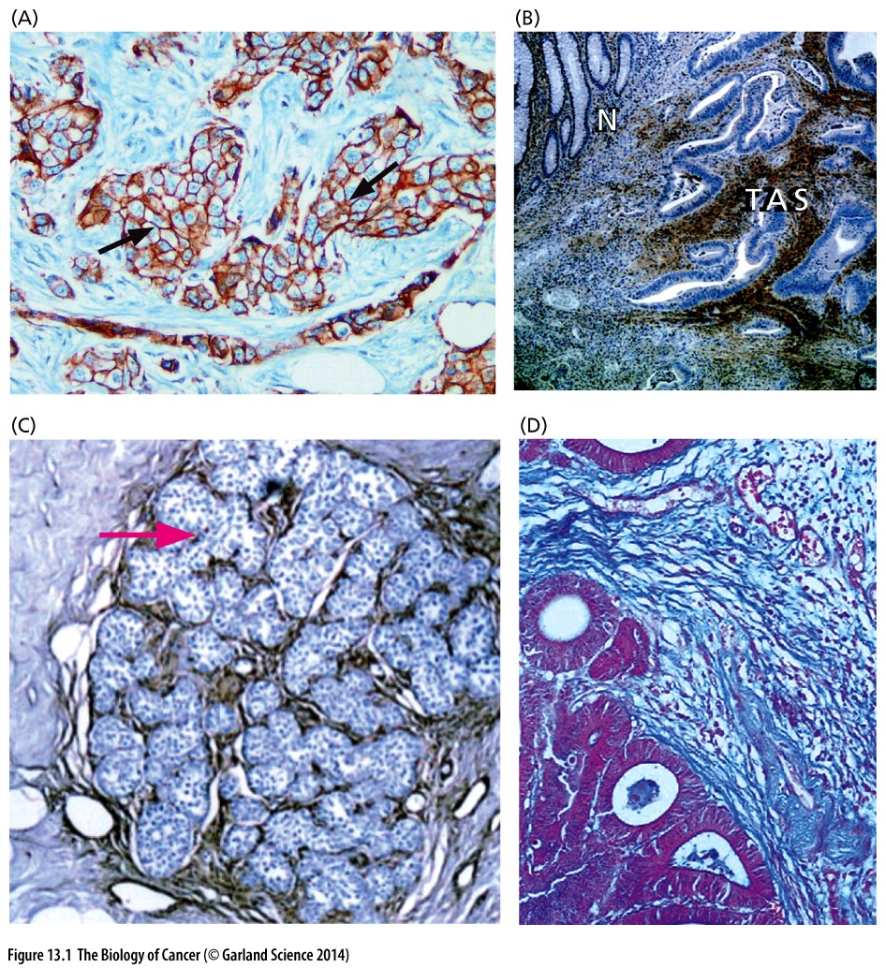
Figure 13.1 Stromal components of several commonly occurring carcinomas
(A) A high-grade invasive ductal carcinoma of the breast, in which the membranes (arrows) of the epithelial cells are stained brown, while the nuclei of the stromal cells are light blue. (B) A colon carcinoma (right side) and normal colonic mucosa (N), in which fibroblast-like cells in the tumor-associated stroma (TAS) are immunostained dark brown for PINCH (a protein associated with the cytoplasmic tails of integrins), while the nuclei of epithelial cancer cells lining ducts are light blue. (C) A lobular(小叶) carcinoma in situ of the breast showing small clusters of cancer cells surrounded by thin layers of stromal fibroblasts that have been immunostained for PINCH antigen (dark brown). (D) An adenocarcinoma of the stomach in which the cancer cells (purple, lower left) are adjacent to extensive stroma, which has been stained for collagen (blue).
Notes:
Tumor purity概念

Slide 5
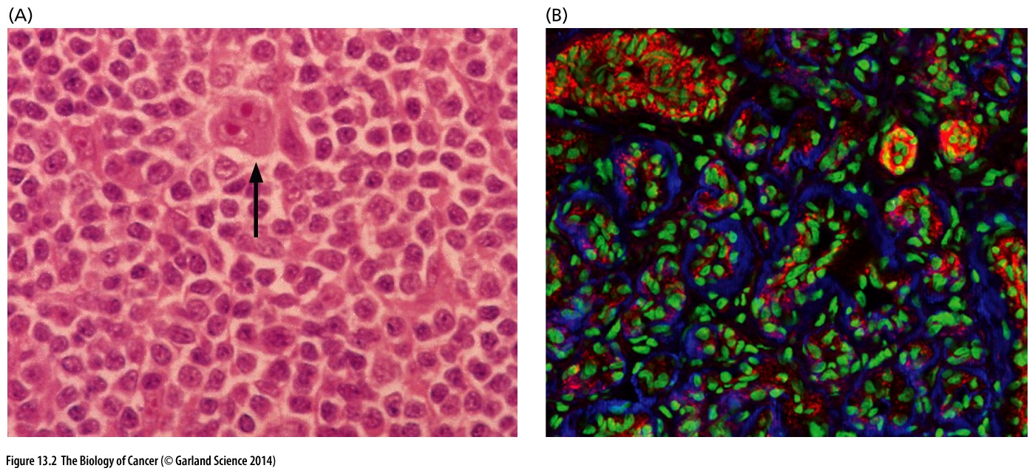
Figure 13.2 Extreme variations in the ratio of neoplastic cells to stroma
(A) In certain tumors, normal, nonneoplastic cells may constitute the great majority of living cells. An extreme form of this is illustrated here by Hodgkin’s disease, a lymphoma in which as many as 99% of the cells are recruited normal lymphocytes, which surround a rare neoplastic Reed–Sternberg cell (arrow).
(B) At the other end of the spectrum are tumors such as the benign hemangioma (血管瘤) shown here, in which neoplastic endothelial cells (green nuclei) form the great bulk of the tumor mass, which is demarcated by basement membranes (blue) and occasional capillaries (red).

Slide 6
Function of stromal cells in tumor
1, orchestrate an inflammatory response that involves the release of TNF-α and prostaglandins, which proceed to stimulate the proliferation and survival of cancer cells;
2, Metastasis;
3, Angiogenesis;
Notes:
One question: 基质细胞中有没有oncogene激活，tumor suppressor灭活过程？

Slide 7
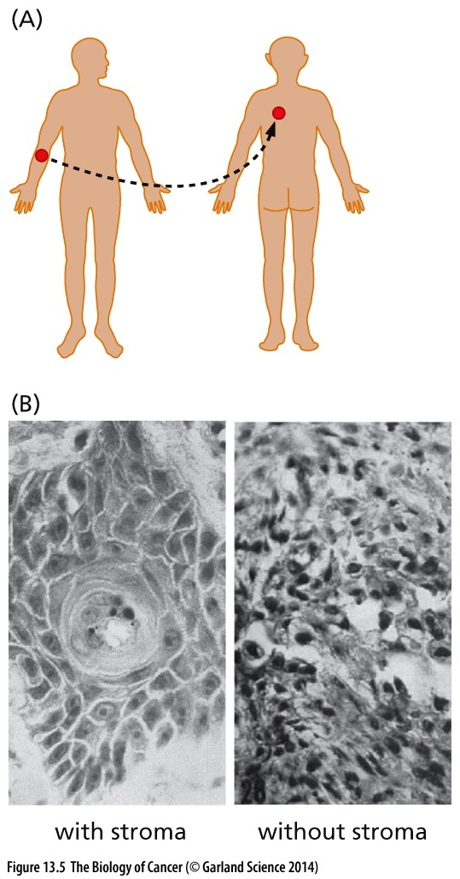
Figure 13.5 Autologous transplantation ( 自体移植) of skin tumors
(A) Basal cell carcinomas of the skin were excised from patients and the carcinoma cells were reimplanted in distant anatomical sites on the skin of the back of the same patients.
(B) The implanted tissues were excised 1 to 5 weeks later. Those that had been implanted together with stroma (left) yielded robustly growing carcinoma cells, while those that were implanted without concomitantly implanted stroma (right) failed to grow and yielded only vacuolated cells and cell debris.
Notes:
首次试验证明stromal cell在肿瘤中的重要作用, Exp performed in 1961

Slide 8
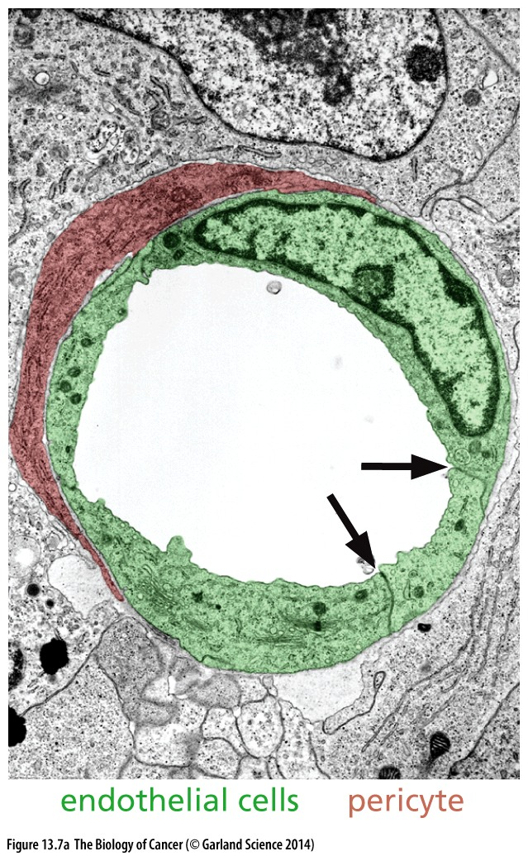
Figure 13.7 Microvessels in normal tissues
(A) This transmission electron micrograph presents a cross section of a capillary within the stroma of a tumor formed by mouse Lewis lung carcinoma cells. The endothelial cell and its nucleus have been colorized green, while the pericyte, which helps maintain capillary rigidity and intraluminal blood pressure, is colorized red.
Both endothelial cells and pericyte are stromal cells.

Slide 9
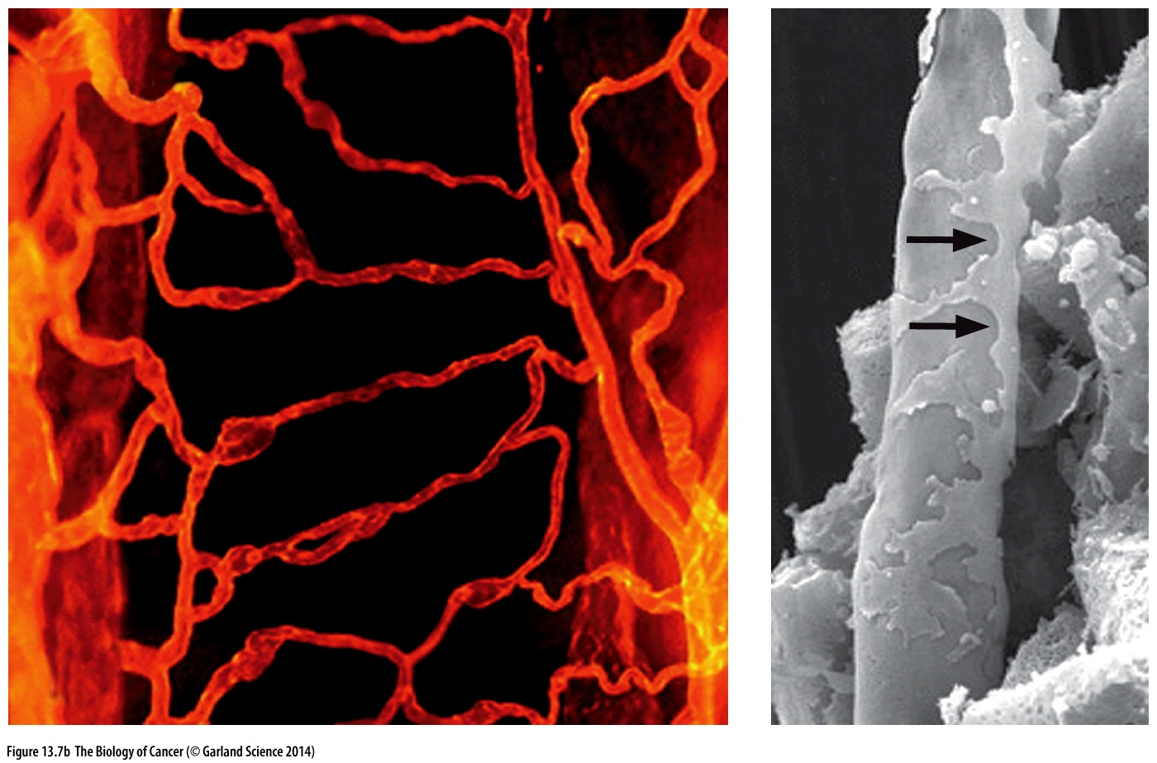
Figure 13.7 Microvessels in normal tissues
(B) Immunofluorescent microscopy of the capillaries in a normal mouse trachea（气管）reveals (using an antibody that recognizes the endothelial cell–specific CD31 antigen) a well-organized network of microvessels. At the level of scanning electron microscopy (right), a capillary is seen to resemble a smooth-walled tube with pericytes (arrows) adhering to its outer surface.

Slide 10
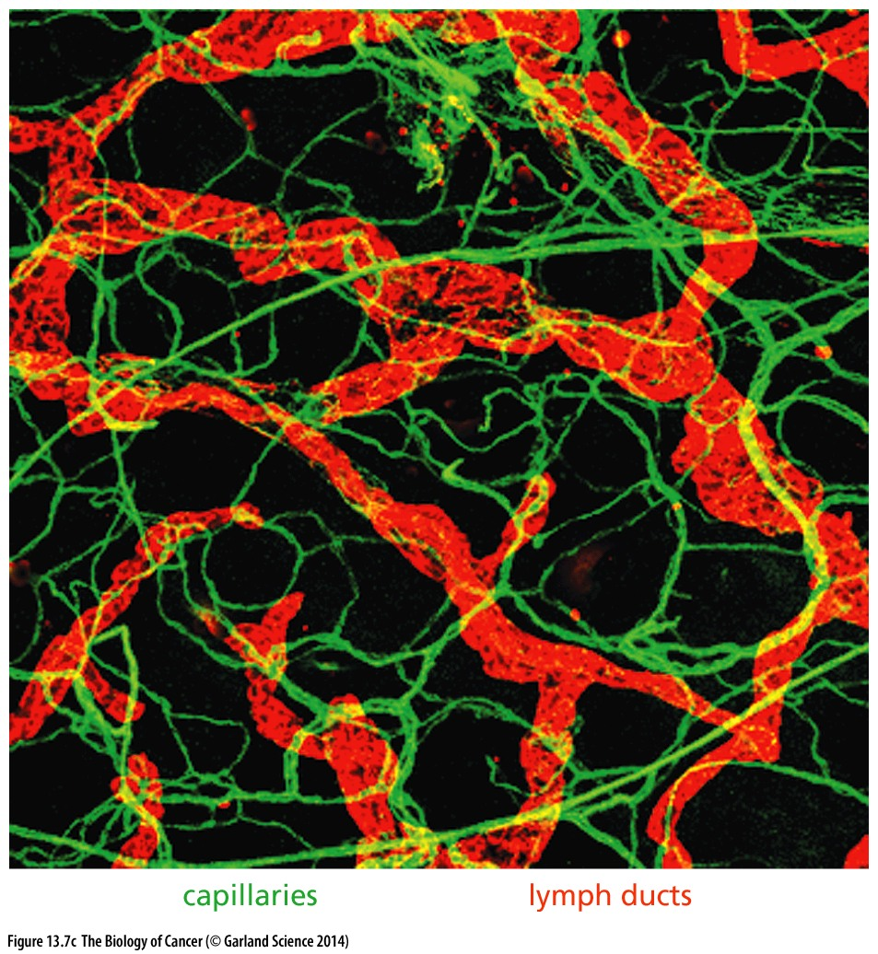
Figure 13.7 Microvessels in normal tissues
(C) Most normal tissues are interlaced with networks of capillaries (green) and lymphatic vessels (red orange). As is apparent here, the diameters of lymphatic vessels are far larger than those of capillaries. Unlike capillaries, however, the endothelial cells of lymphatic vessels are not supported by underlying mural cells—pericytes and smooth muscle cells (not shown).

Slide 11
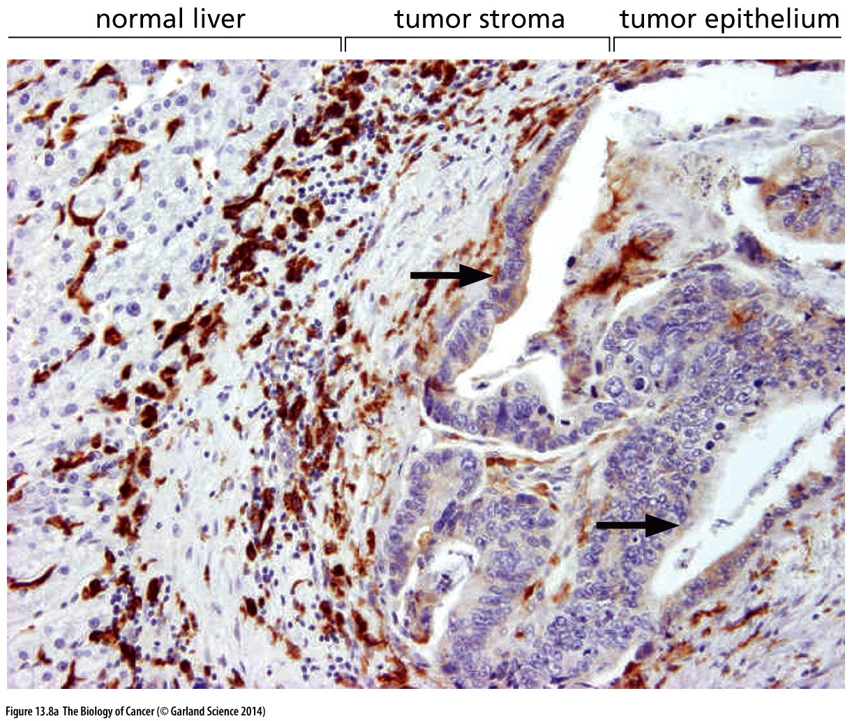
Figure 13.8 Metastasis and dependence on stroma
(A) This micrograph of a metastasis originating from a primary colon carcinoma reveals that the metastasis found in the liver is as complex histologically as the primary tumors. Here, we see that the carcinoma cells that have formed a metastasis (light purple, right) have constructed the same ductal（管的）structures (arrows) as are seen in primary adenocarcinomas of the colon. In addition, the carcinoma cells have recruited substantial（大量的）stroma (middle), which includes macrophages (dark brown).
Immunohistochemistry staining

Slide 12
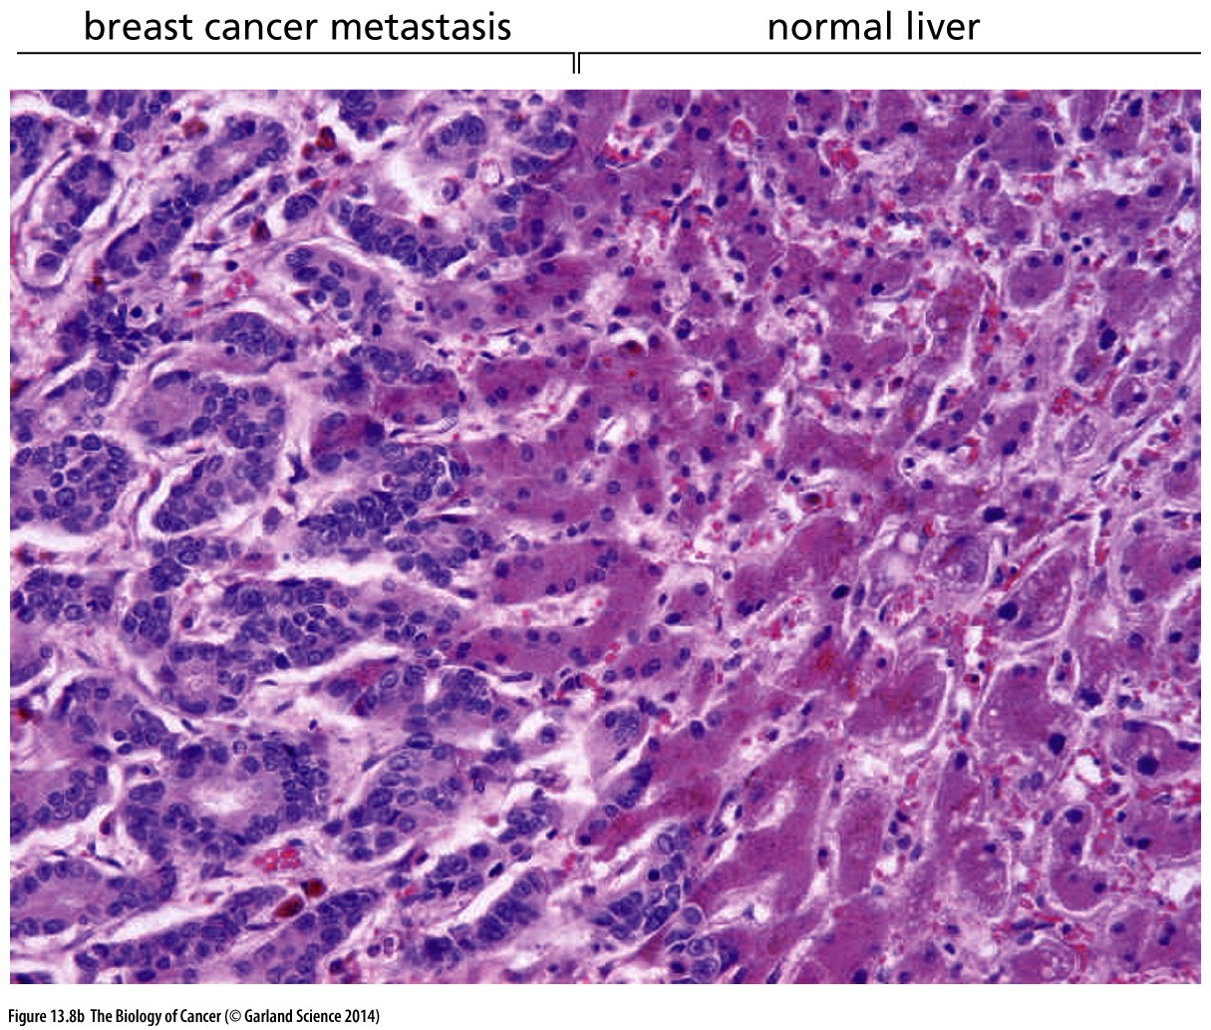
Figure 13.8 Metastasis and dependence on stroma
(B) Most breast cancer metastases to the liver (left) behave quite differently from colon carcinoma metastases to this organ, in that the
mammary carcinoma cells infiltrate into normal liver tissue (right) and displace resident hepatocytes, thereby taking advantage of the existing stroma, including its vasculature.

Slide 13
13.2 The cells forming cancer cell lines develop without heterotypic interactions and deviate from the behavior of cells within human tumors
Create cancer cell lines from tumor biopsies is very difficult, because…

Slide 14
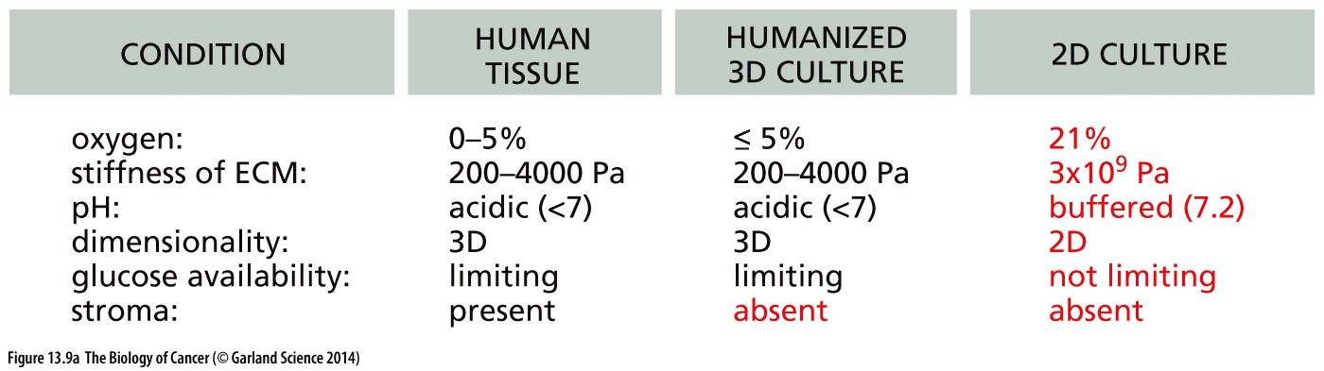
Sidebar 13.1 The development of anti-cancer therapies has been imperfectly served by the use of existing human cancer cell lines

Slide 15
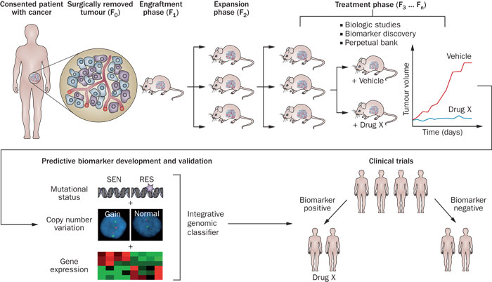
Patient-Derived Xenograft (PDX) Models
(PDTX) are created when cancerous tissue from a patient’s primary tumor is implanted directly into an immunodeficient mouse.

Slide 16
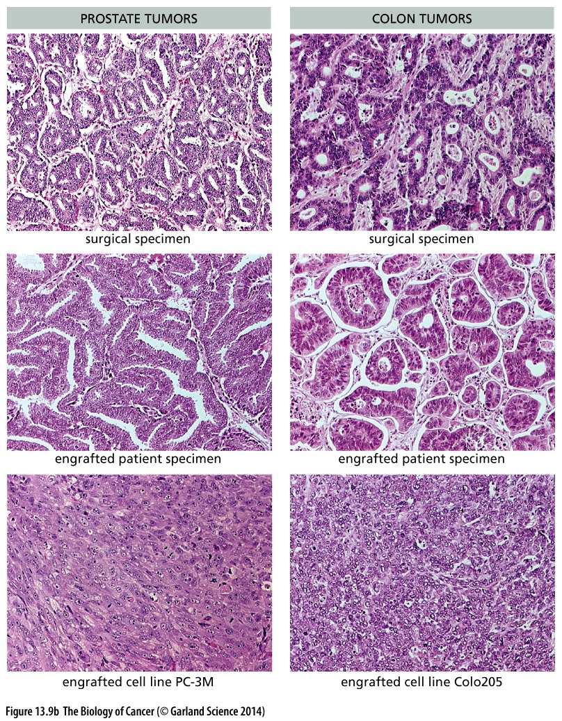
Figure 13.9 Tumors and derived xenografted tumor cell lines
Cell line maybe not a good represent of original tumor!

Slide 17
13.3 Tumors resemble wounded tissues that do not heal
Notes:
以前我们从细胞角度看肿瘤，现在从组织角度看肿瘤…

Slide 18
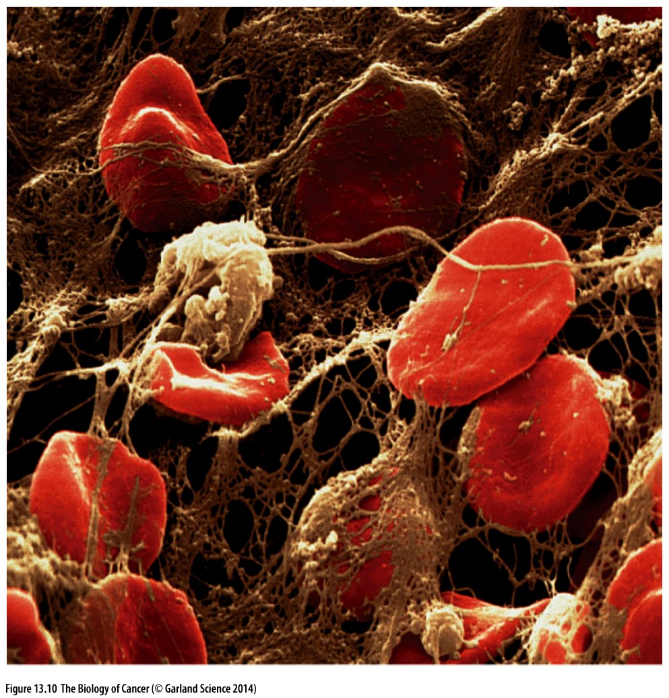
Figure 13.10 Scanning EM of a blood clot
This scanning electron micrograph, which has been colorized, shows that clots are composed of dense networks of fibrin(血纤维蛋白) fibers (light brown) that have trapped red blood cells (red). Prior to clotting, platelets undergo activation, which leads to the release of the granules seen in Figure 5.3.

Slide 19
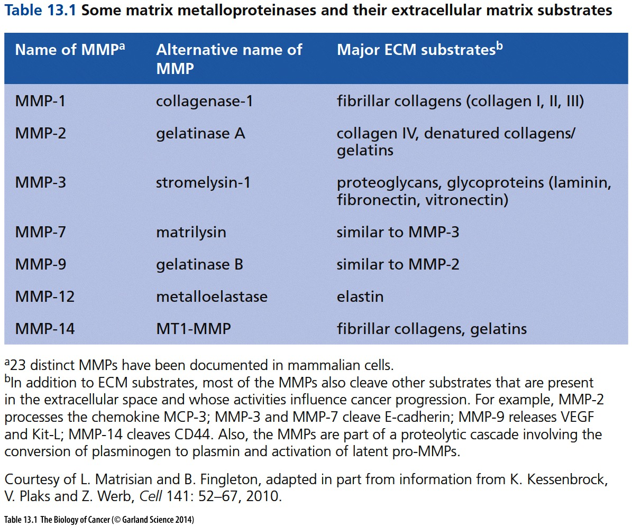
Function of metalloproteinase (金属蛋白酶)---degrade ECM,
Consequence:
1, ECM remodeling;
2, release growth factors;

Slide 20
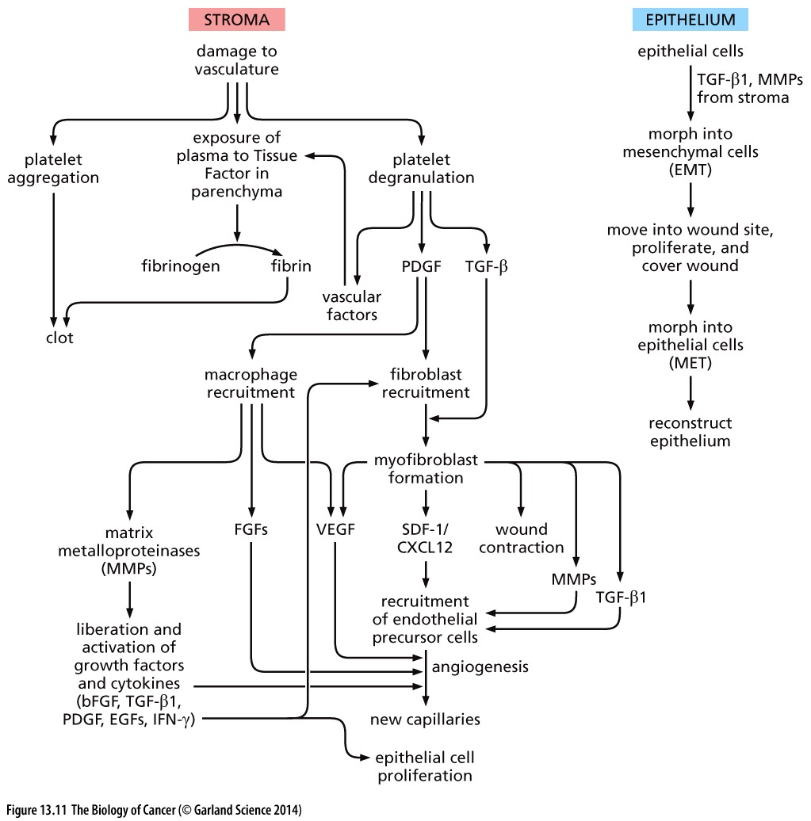
Figure 13.11 Flowchart of wound healing（伤口愈合）
These flowcharts indicate the major events occurring after an epithelial tissue is wounded. Many of the changes occur in the stroma of the wounded tissue (left) and thereby provide a foundation for reconstructing the epithelial cell layer (right). A short-term effect of wounding is the process of hemostasis（止血）. It involves both the plugging(塞) of damaged vessels and the degranulation of platelets, which release a number of distinct growth factors (GFs), including importantly PDGF and TGF-β; in addition, the exposure of plasma and platelets to Tissue Factor triggers the formation of fibrin and thus clot formation. PDGF and TGF-β recruit and activate both macrophages and fibroblasts. Macrophages, in turn, produce a number of products that are critical to initiating wound healing, including MMPs (to remodel the extracellular matrix and liberate various GFs); this allows recruitment of more macrophages and stimulates the proliferation of epithelial cells. The fibroblasts are activated by the actions of TGF-β and CXCL12/SDF-1 and, as myofibroblasts (see Figure 13.16), produce more of these factors that function, together with macrophage products, to stimulate angiogenesis.

Slide 21
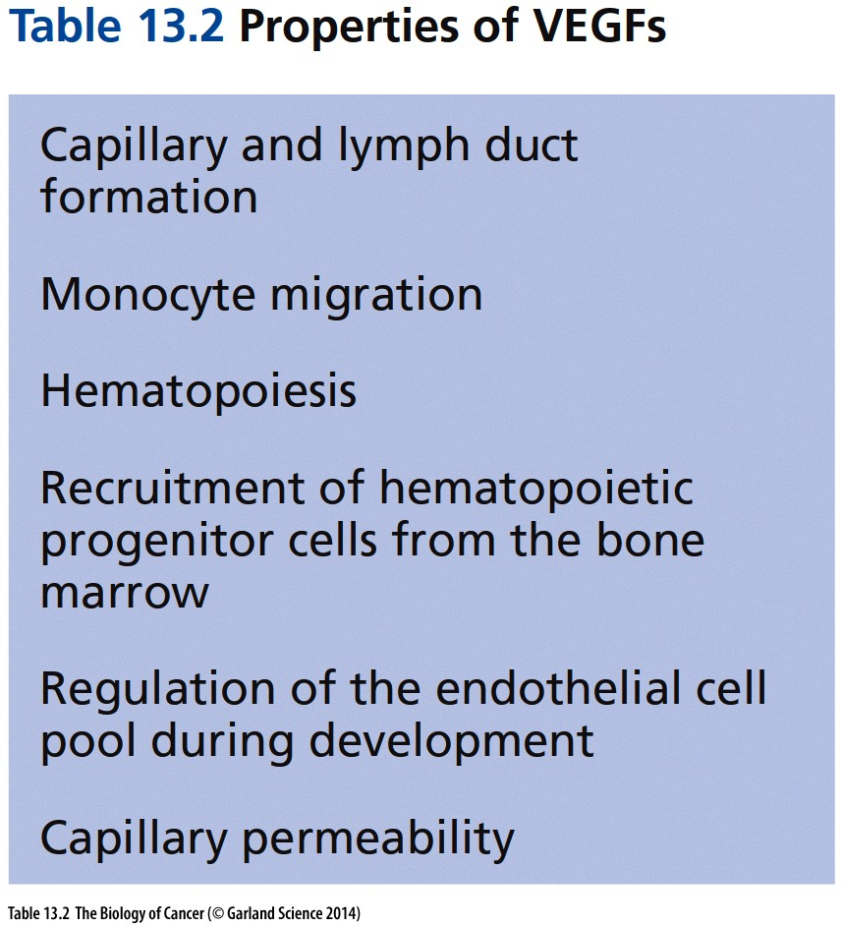

Slide 22
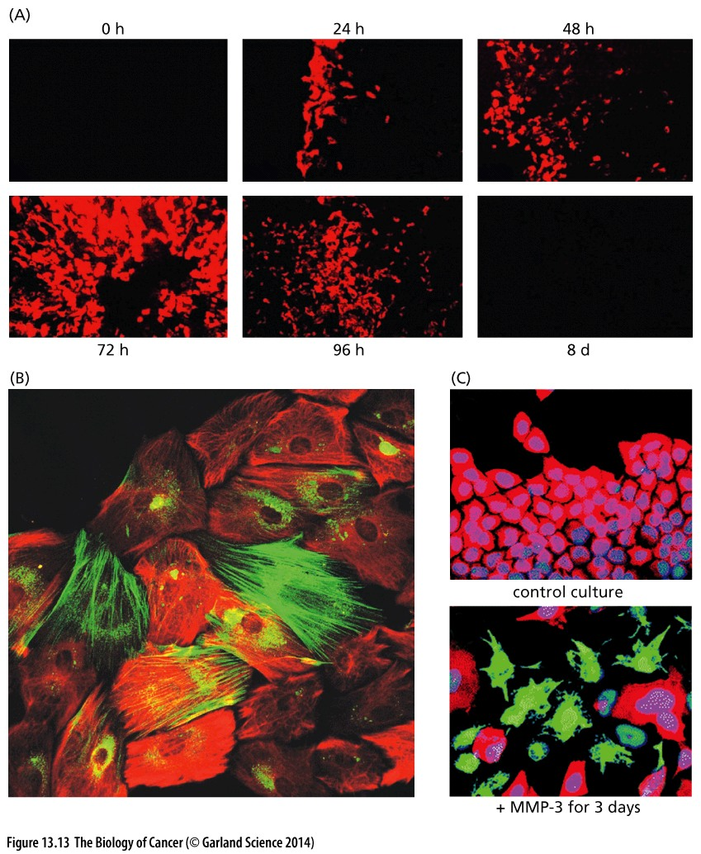
Figure 13.13 The epithelial– mesenchymal transition
(A) A confluent monolayer of MCF10A cells, a line of nontransformed, immortalized human mammary epithelial cells (MECs), has been disturbed by removal of a patch of cells (at left of each image). Before wounding, no vimentin is expressed by these cells. However, soon after wounding, the epithelial cells at the edge of the wound undergo a partial epithelial–mesenchymal transition (EMT), express vimentin (characteristic of mesenchymal cells; red), migrate into the wound site, proliferate, and fill the wound site.

Slide 23
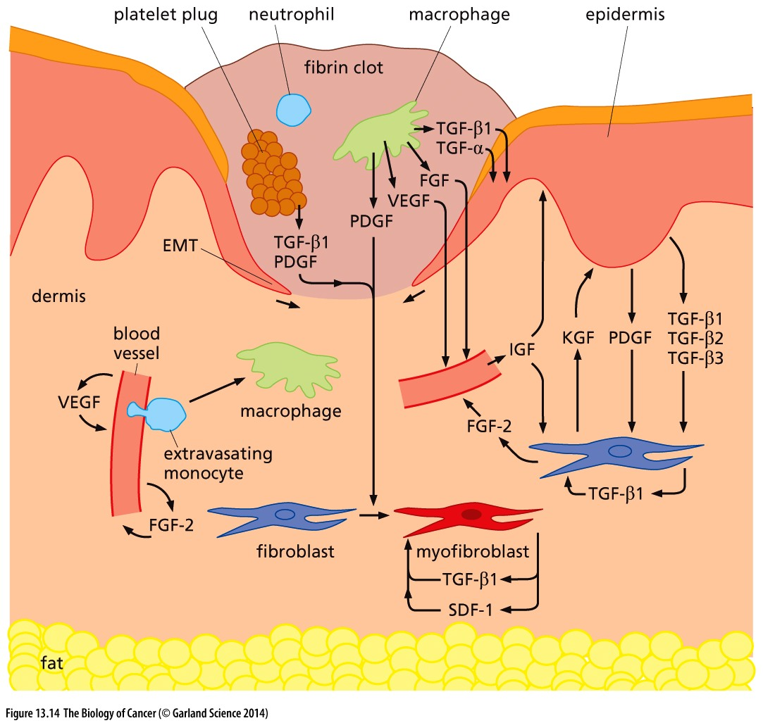
Figure 13.14 The program of wound healing（伤口愈合）
This drawing depicts the heterotypic signaling occurring after the skin is wounded. A fibrin clot initially fills the wound site. Day 3 of the wound-healing process is sometimes termed its inflammatory phase, because of the involvement of cell types that are associated with inflammation, notably neutrophils and monocytes. In addition, macrophages, which derive from differentiation of monocytes, release TGF-β1 and TGF-α; these factors stimulate the proliferation of nearby epithelial cells from the epidermis and induce them to undergo an epithelial–mesenchymal transition (EMT). Tongues of the resulting cells, now exhibiting mesenchymal behavior, invade under the clot from both sides in order to cover the wound site. At the same time, TGF-β1 and PDGF-A and -B, which were released by the platelets during initial clot formation, stimulate the proliferation of fibroblasts (blue purple) in the underlying dermal stroma and induce them to convert into the activated fibroblasts termed myofibroblasts (red); because of their contractility, myofibroblasts will pull the sides of the wound together. Finally, after the wounded stroma is covered, the cells that had undergone an EMT revert, via a mesenchymal–epithelial transition (MET), to an epithelial state, thereby reconstituting the epithelium.

Slide 24
Wound healing vs tumorigenesis
If we compare wound healing with the interactions of epithelial cancer cells and their stromal neighbors, we find striking parallels between wound healing and tumorigenesis. One clear similarity between the two processes derives from the presence of clumps of fibrin in the tumor-associated stroma. In the case of tumors, this does not derive from traumatic damage to blood vessels. Instead, the capillaries within tumors are constitutively leaky, unlike those in normal tissues (Figure 13.15A).

Slide 25
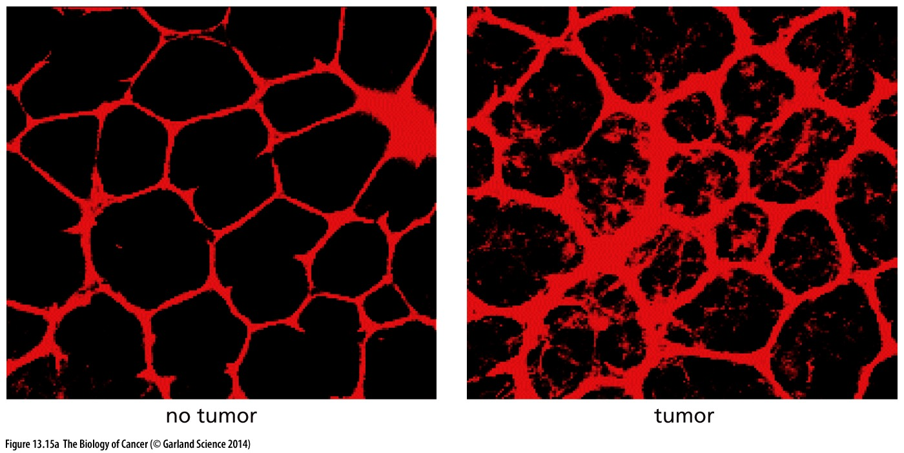
Figure 13.15 Capillary leakiness and deposition of fibrin bundles in the tumor-associated stroma
(A) Injection of red dextran dye into
normal microvasculature reveals that
the walls of associated capillaries
have relatively low permeability, as
indicated by the sharply delineated
profiles of these vessels (left). However,
when injected into tumor-associated
vasculature, the dye leaks out of
the capillaries and diffuses into the
nearby parenchyma, yielding diffusely
staining outlines of vessels (right).
Useful for drug delivery

Slide 26
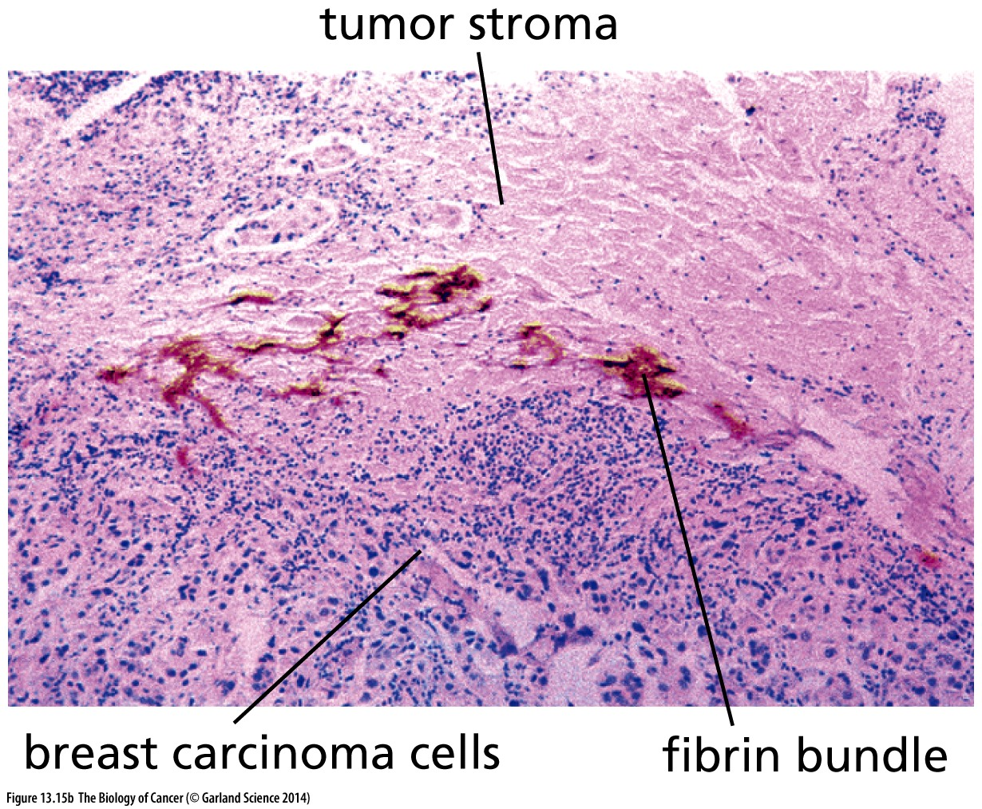
Figure 13.15 Capillary leakiness and deposition of fibrin bundles in the tumor-associated stroma
(B) The leakiness of tumor-associated microvasculature results in the continuous leaking of thrombin and fibrinogen molecules from the plasma into the parenchyma surrounding blood vessels. Tissue Factor, a protein displayed on the surface of cancer cells and many other nonendothelial cell types (see also Figure 13.11), activates plasma-derived thrombin upon contact, whereupon thrombin converts fibrinogen into fibrin. This results in the extensive network of fibrin bundles (dark red) seen here at the border between actively growing breast cancer cells (below) and the tumor stroma (above).

Slide 27
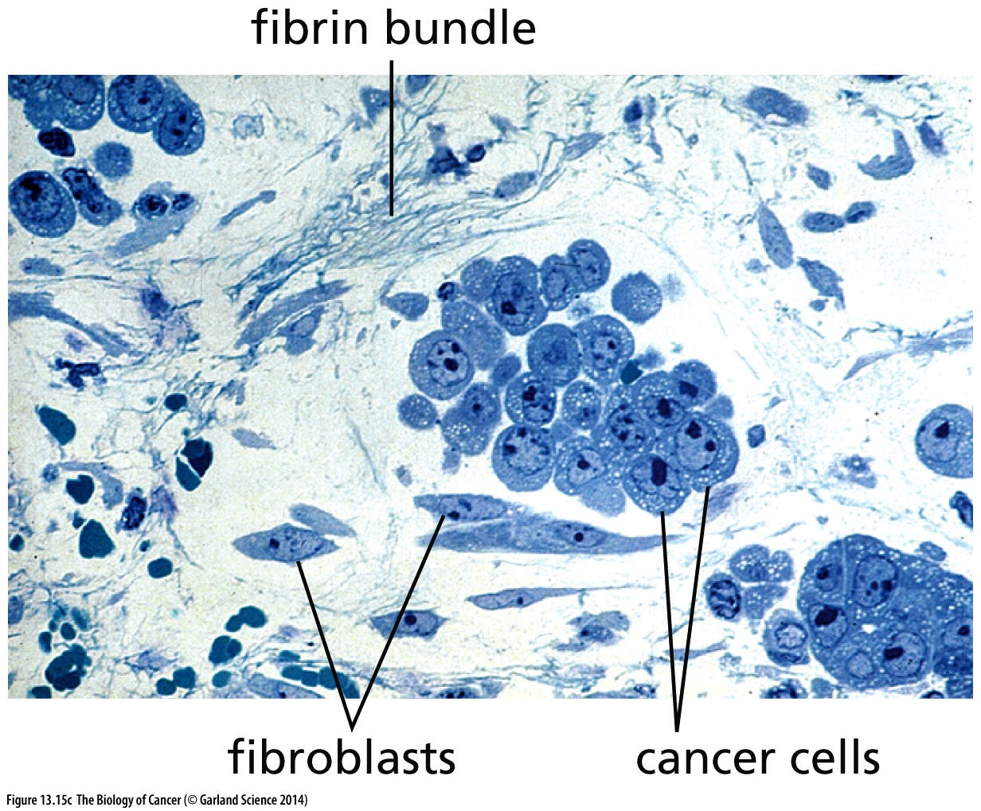
Figure 13.15 Capillary leakiness and deposition of fibrin bundles in the tumor-associated stroma
(C) The fibrin bundles form an extracellular matrix to which migrating cells, such as fibroblasts (below cluster of cancer cells) as well as endothelial cells (not seen), can attach, using it as a substrate on which they can move forward.

Slide 28
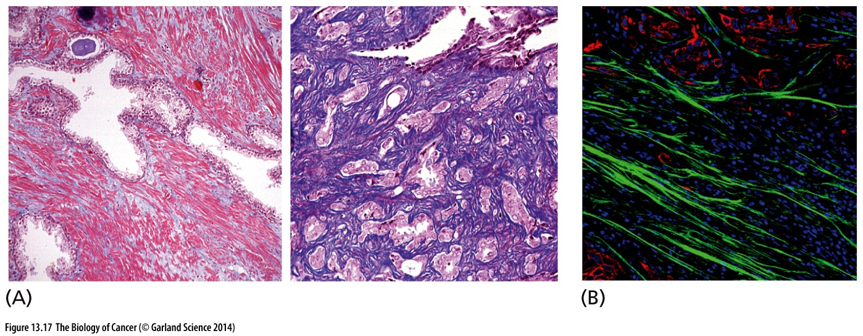
Figure 13.17 Micrograph of normal stroma and desmoplastic（促结缔组织增生的）stroma
(A)Normal human prostate tissue (left panel) stained with Masson’s trichrome stain, which reveals the extensive smooth muscle cells in the stroma as pink; normal ducts are scattered throughout this stroma. In contrast, an advanced prostate carcinoma (right panel) stained identically and viewed at the same magnification reveals the extensive desmoplastic stroma (blue purple), which is rich in extracellular matrix, notably collagen I (B) In this invasive ductal carcinoma of the breast, the deposition of parallel collagen fibers by fibroblasts and myofibroblasts (green) creates a stiff extracellular matrix in the desmoplastic stroma that encourages epithelial-mesenchymal transitions in nearby carcinoma cells (red).

Slide 29
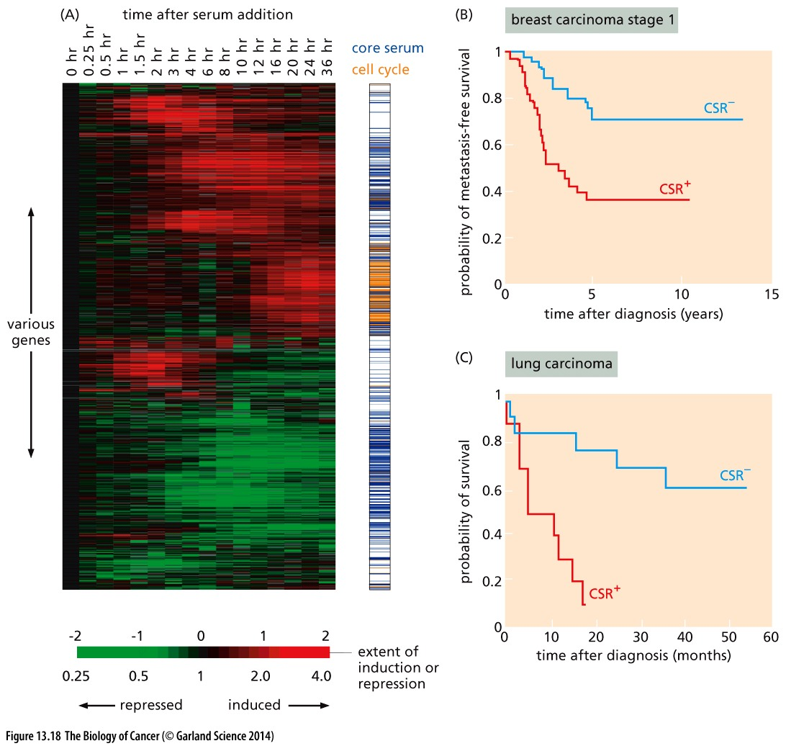
Figure 13.18 Gene expression arrays of tumor-associated myofibroblasts and serum-activated fibroblasts
Serum-activated fibroblasts: fibroblast in wound site
Notes:
Wound healing 和 tumorigenesis类似的一个原因。

Slide 30
13.4 Experiments directly demonstrate that stromal cells are active contributors to tumorigenesis

Slide 31
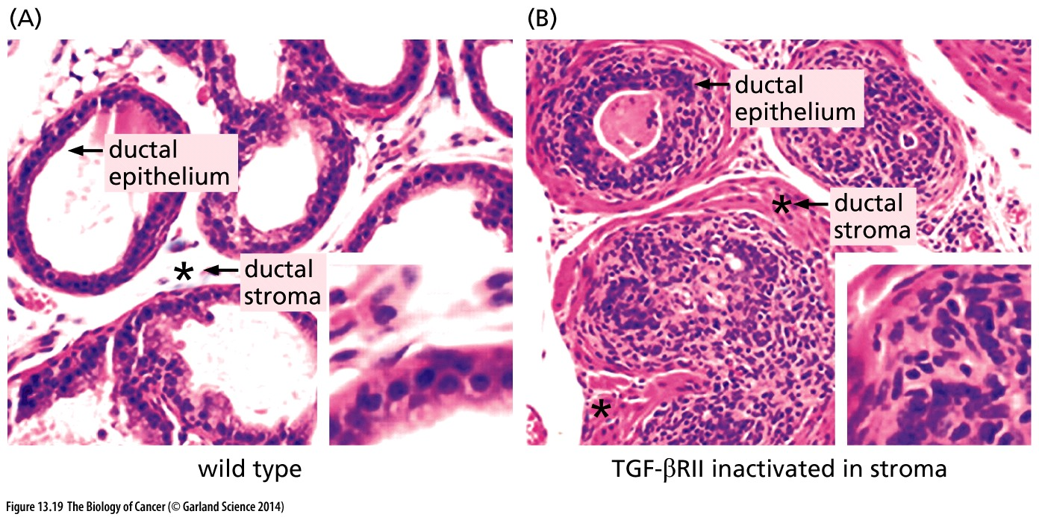
Figure 13.19 Prostatic tumors from mice with genetically altered stromal fibroblasts
(A) The prostates of male mice normally exhibit a thin layer of epithelial cells lining the lumina of the ducts and a relatively thin layer of stromal cells (asterisk) outside the epithelial cell layers.
(B) As a consequence of TGF-β type II receptor inactivation in the stromal fibroblasts, both cell layers became Hyperplastic. This suggests that the hyperplastic stroma released proliferative signals to the nearby epithelium.

Slide 32
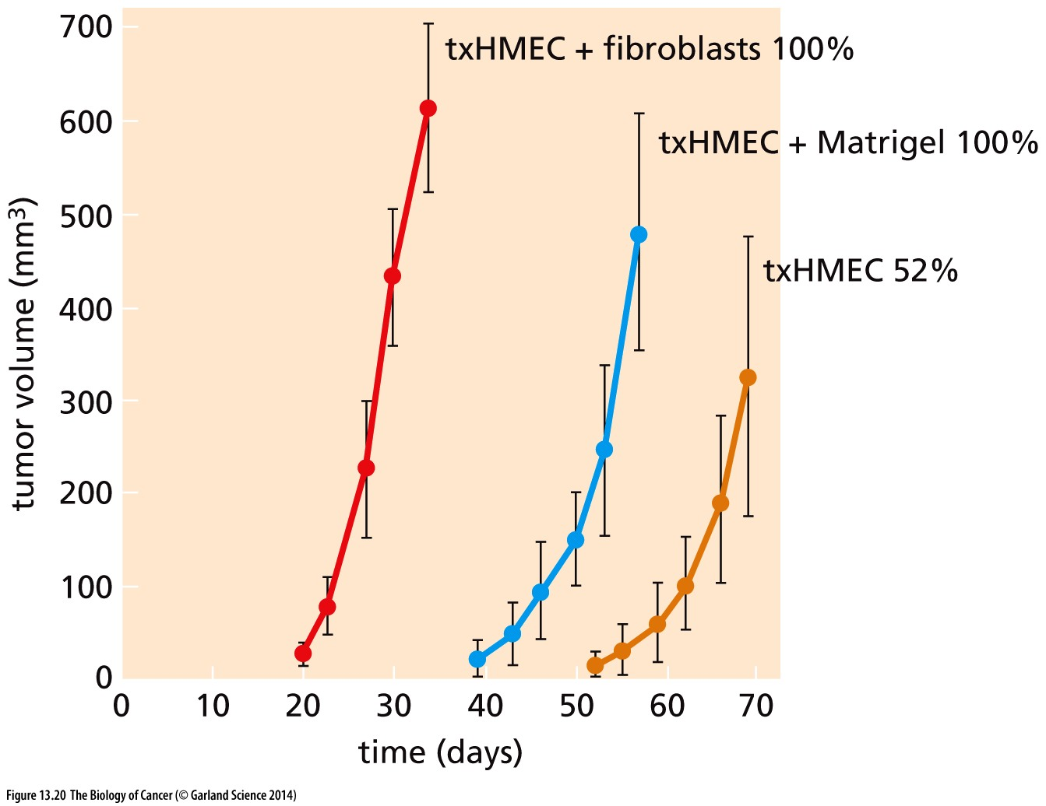
Figure 13.20 Admixed fibroblasts and tumor growth
When human mammary epithelial cells (HMECs) were transformed through the introduction of the SV40 early region, the hTERT gene, and a weakly expressed ras oncogene, the resulting transformed HMECs (txHMECs) formed tumors, albeit with a long lag time after injection, and then only in about half of the mice into which they had been injected (orange curve). However, when mammary stromal fibroblasts from a normal human breast were admixed to the transformed human MECs prior to injection, the cancer cells formed tumors rapidly and with 100% efficiency (red curve).

Slide 33
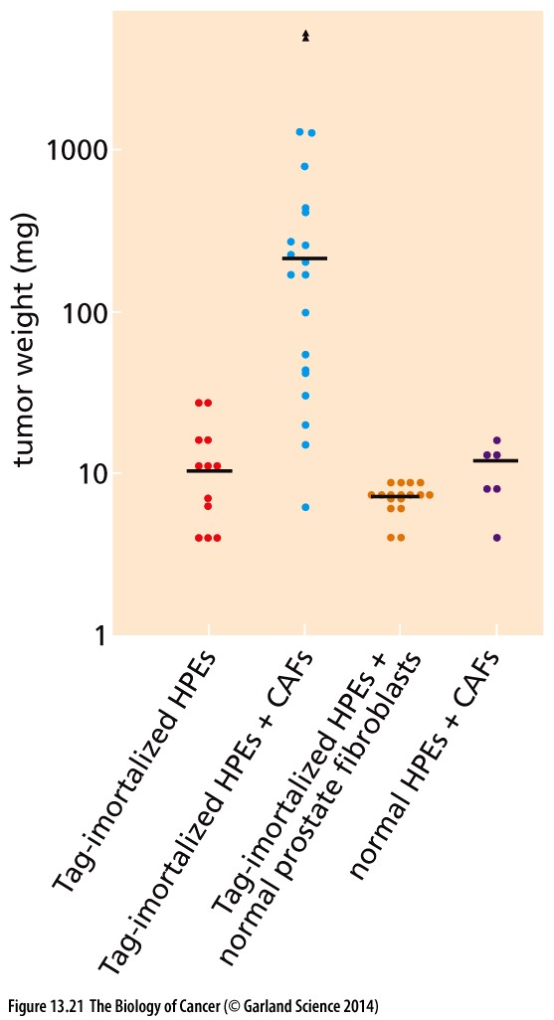
Figure 13.21 Effects of prostatic stromal cells on immortalized prostatic epithelial cells
When normal human prostate epithelial cells (HPEs) that had been immortalized by SV40 T antigen (Tag-immortalized HPEs) were introduced into Nude mice, they formed growths of ~10 mg after many weeks, not significantly larger than the initial inoculum (red dots), indicating that these cells were, when implanted on their own, non-tumorigenic. However, if these same cells were mixed with carcinoma-associated fibroblasts (CAFs) prepared from a human prostate carcinoma, tumors arose whose median weight was 10 times larger (Tag-immortalized HPEs + CAFs, blue dots).

Slide 34
13.5 Macrophages and myeloid cells play important roles in activating the tumor-associated stroma
The active recruitment of macrophages into tumor masses would seem, at first glance, to be counterproductive for tumor formation, since macrophages are usually deployed by the immune system to scavenge and destroy infectious agents and abnormal cells, as we will explore in more detail in Chapter 15. However, increasing evidence indicates that these immune cells also play important roles in furthering tumor development.
Notes:
Macrophage对肿瘤个影响具有两面性，部分macrophage抑制肿瘤，部分macrophage促进肿瘤。

Slide 35
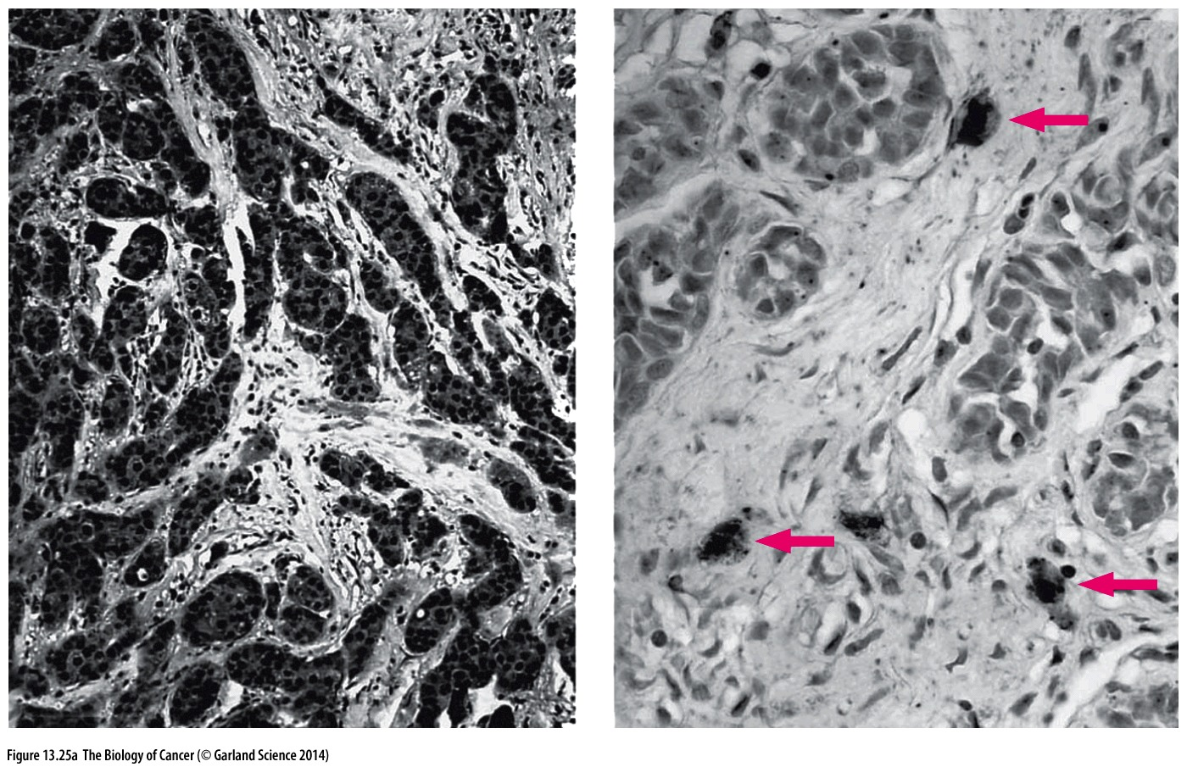
Figure 13.25 Macrophage involvement in angiogenesis
(A) In certain breast tumors (left panel),
the cancer cells synthesize the potent
angiogenic factor VEGF (vascular
endothelial growth factor), revealed
here (dark areas) by staining with
an anti-VEGF monoclonal antibody.
However, in other breast tumors (right
panel), VEGF production originates
in isolated macrophages within the
tumor-associated stroma (arrows).

Slide 36
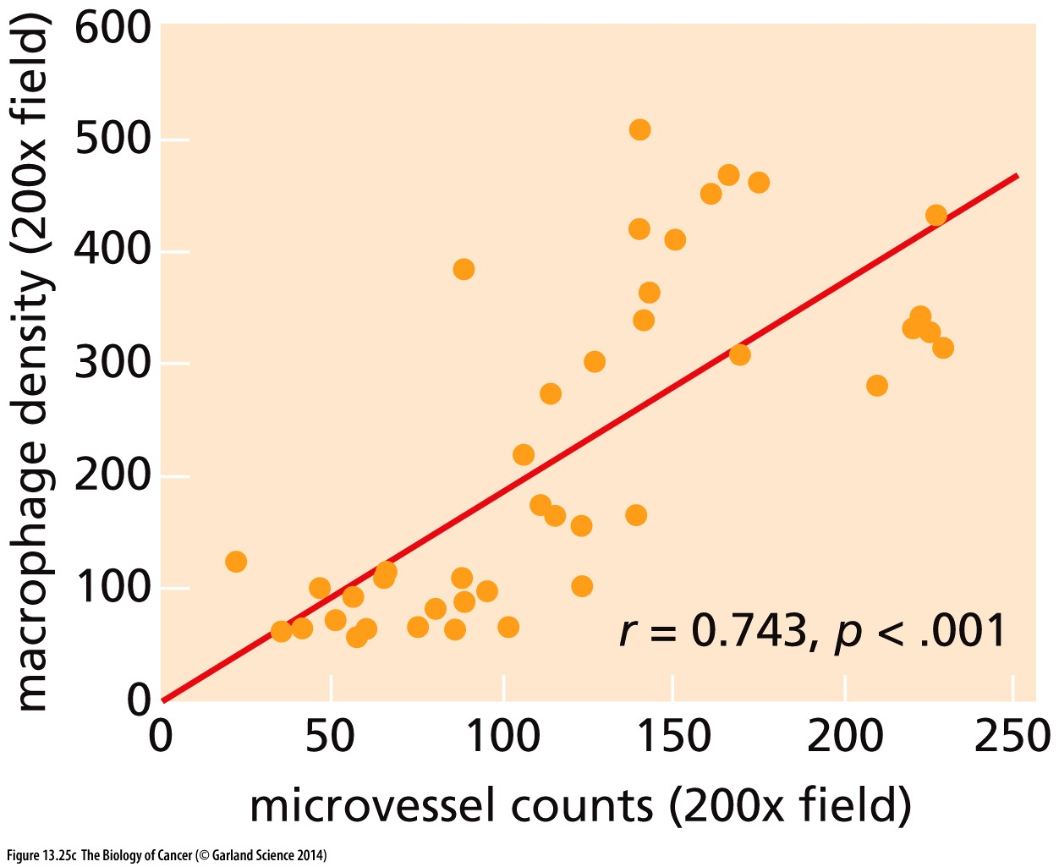
Figure 13.25 Macrophage involvement in angiogenesis
(C) In a series of human non-small-cell lung carcinoma (NSCLC) specimens, each represented here by a point on the graph, the density of tumorassociated macrophages (TAMs) per microscope field has been plotted vs. the density of microvessels (i.e., capillaries). Such correlations add further weight to the notion that TAMs play a key role in fostering tumor-associated angiogenesis.

Slide 37
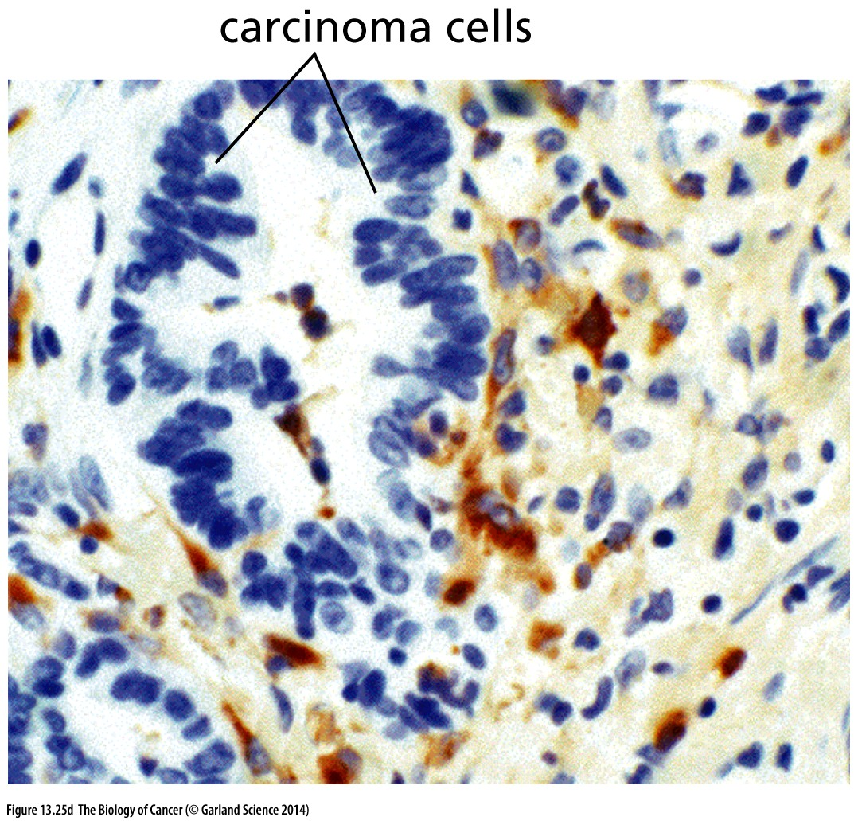
Figure 13.25 Macrophage involvement in angiogenesis
(D) Macrophages in the stroma of a human colorectal adenocarcinoma produce matrix metalloproteinase-9 (MMP-9; brown spots), a key enzyme in angiogenesis that acts by liberating angiogenic factors from the ECM.
Macrophage → MMP-9 → VEGF → angiogenesis

Slide 38
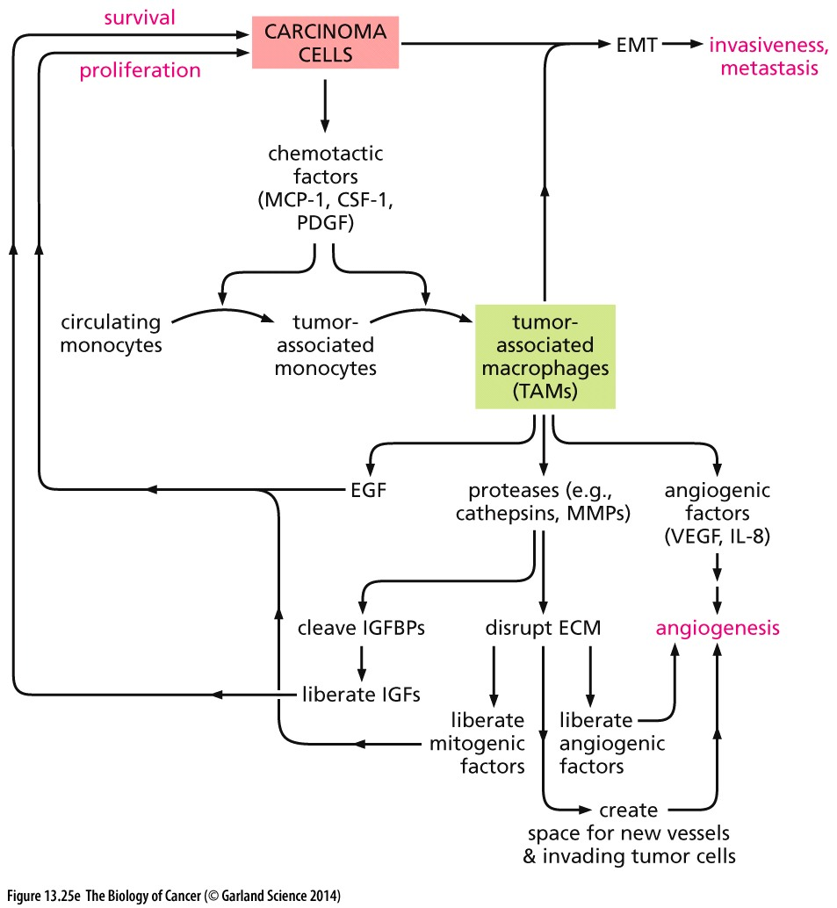
Figure 13.25 Macrophage involvement in angiogenesis
(E) Macrophages play a major role in releasing mitogenic factors for carcinoma cells as well as reorganizing the tumor stroma in order to facilitate angiogenesis and, in some tumors, carcinoma cell invasiveness. MMPs, matrix metalloproteinases.
Notes:
仅供参考

Slide 39
History of Angiogenesis study
The essential role of angiogenesis in tumor growth was first proposed in 1971 by Judah Folkman
In 1971, Folkman published in the “New England Journal of Medicine” a hypothesis that tumor growth is angiogenesis dependent and that inhibition of angiogenesis could be therapeutic. This article also introduced the term anti-angiogenesis to mean the prevention of new vessel sprout from being recruited by a tumor. The hypothesis predicted that tumors would be unable to grow beyond a microscopic size of 1–2 mm³ without continuous recruitment of new capillary blood vessels.

Slide 40
13.6 Endothelial cells and the vessels that they form ensure tumors adequate access to the circulation

Slide 41
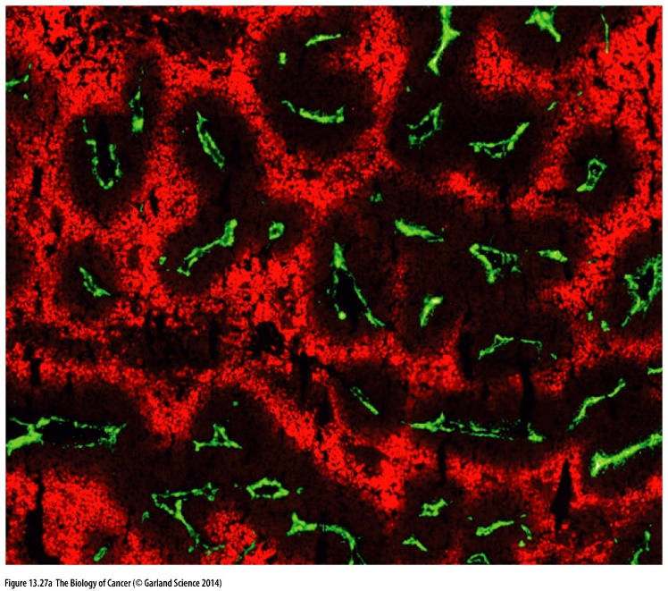
Figure 13.27 Hypoxia and necrosis of cells in poorly vascularized sections of tissues
Capillary: Green;
Hypoxia: Red;

Slide 42
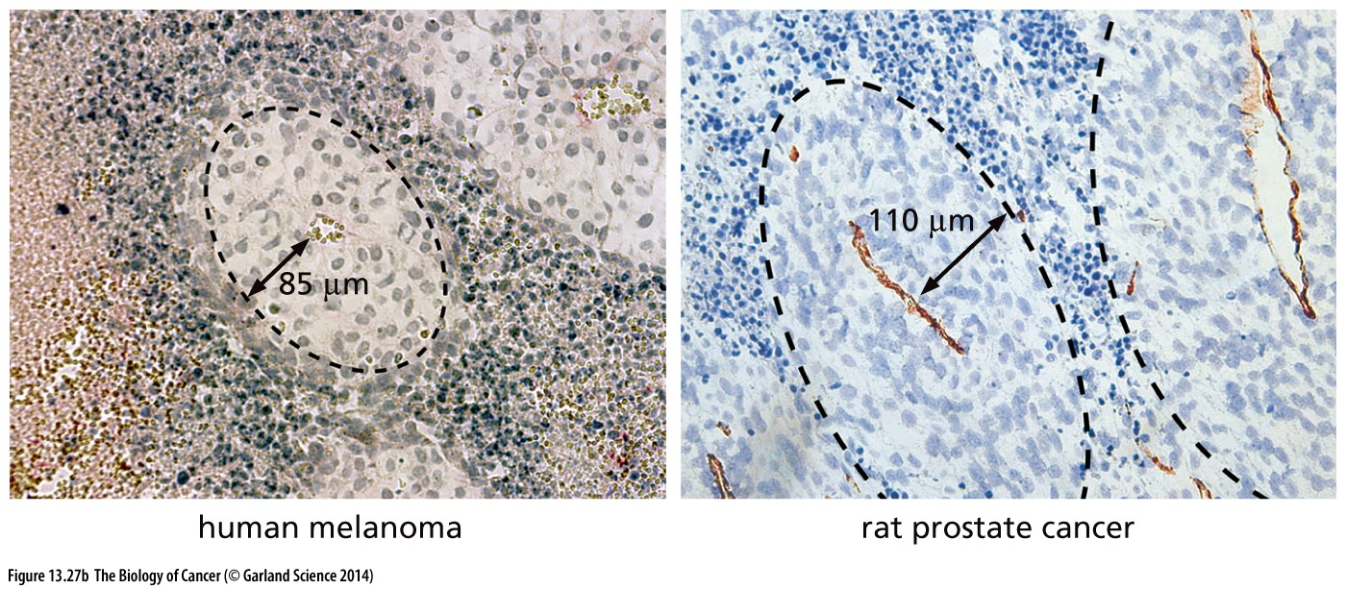
Figure 13.27 Hypoxia and necrosis of cells in poorly vascularized sections of tissues
Dead cells
Healthy cells
capillary

Slide 43
Figure 13.27 Hypoxia and necrosis of cells in poorly vascularized sections of tissues
The most obvious stromal support required by tumors has already been cited repeatedly in this chapter: like normal tissues, tumors require access to the circulation in order to grow and survive. As early as the mid-1950s, pathologists noted that cancer cells grew preferentially around blood vessels. Those tumor cells that were located more than about 0.2 mm away from blood vessels were found to be non growing, while others even farther away were seen to be dying (Figure 13.27A).

Slide 44
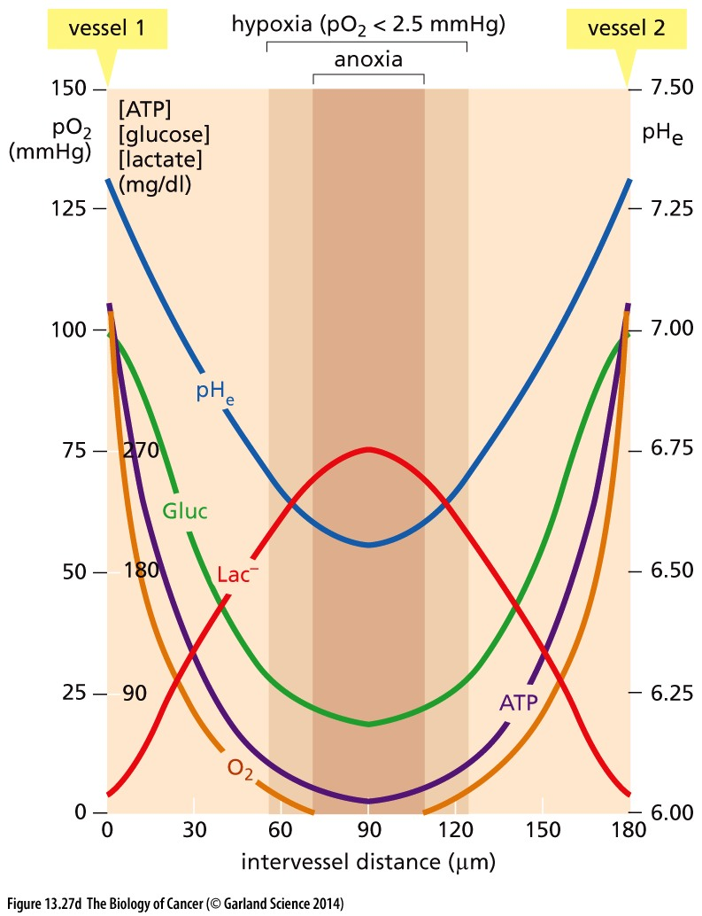
Figure 13.27 Hypoxia and necrosis of cells in poorly vascularized sections of tissues
(D) Measurements of five parameters indicate the dramatic changes that occur with increasing distance from microvessels within tumors. Parameters have been calculated from two arterioles running in parallel, 180 μm apart. pHe represents the pH of extracellular fluid. These measurements in aggregate explain why cells that are situated at some distance from a microvessel experience a sub-optimal environment that often leads to their death by necrosis.

Slide 45
Oxygen concentration and hypoxia
Atmosphere: 20-21%
Most tissues: 3-5%
Hypoxia: < 1%

Slide 46
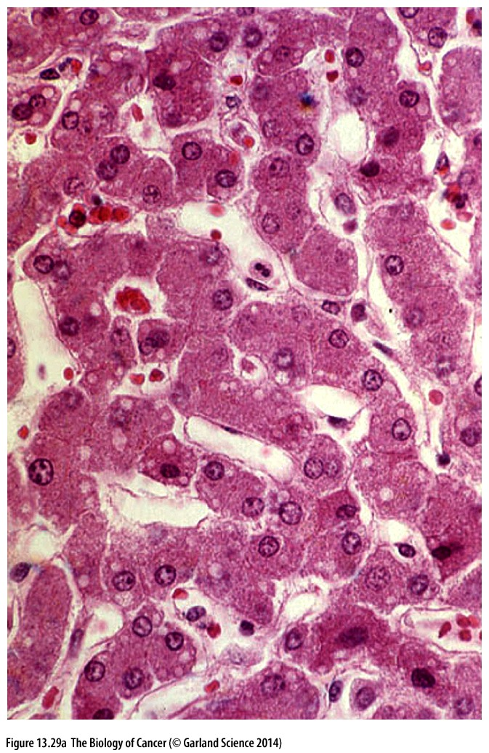
Figure 13.29 Dense microvasculature in normal liver and muscle
Because of high metabolic rates, certain tissues develop an extremely high density of capillaries, ensuring almost every cell direct contact with endothelial cells and the capillaries that they form. (A) Virtually every hepatocyte in the liver is adjacent to a space, termed a sinusoid (窦状毛细血管), that is lined with endothelial cells and serves as a capillary.

Slide 47
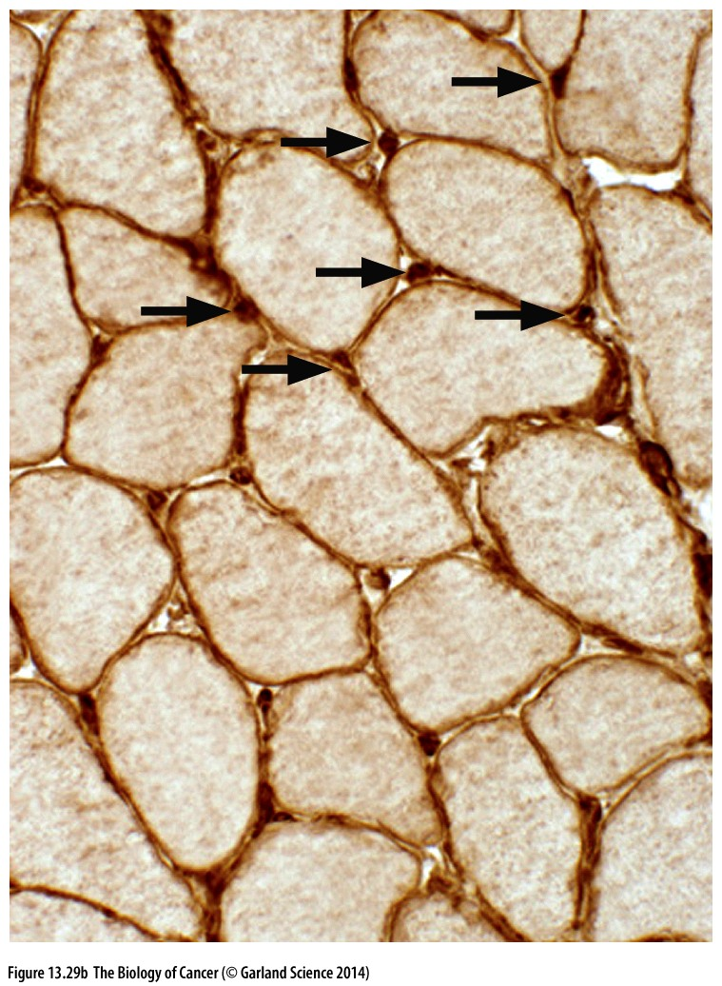
Figure 13.29 Dense microvasculature in normal liver and muscle
(B) Each muscle fiber, immunostained with an anti-laminin antibody, is a single syncytial (多核体的)cell, formed by the fusion of a number of myoblasts. Each muscle fiber lies adjacent to one or more capillaries (arrows, dark brown spots).

Slide 48
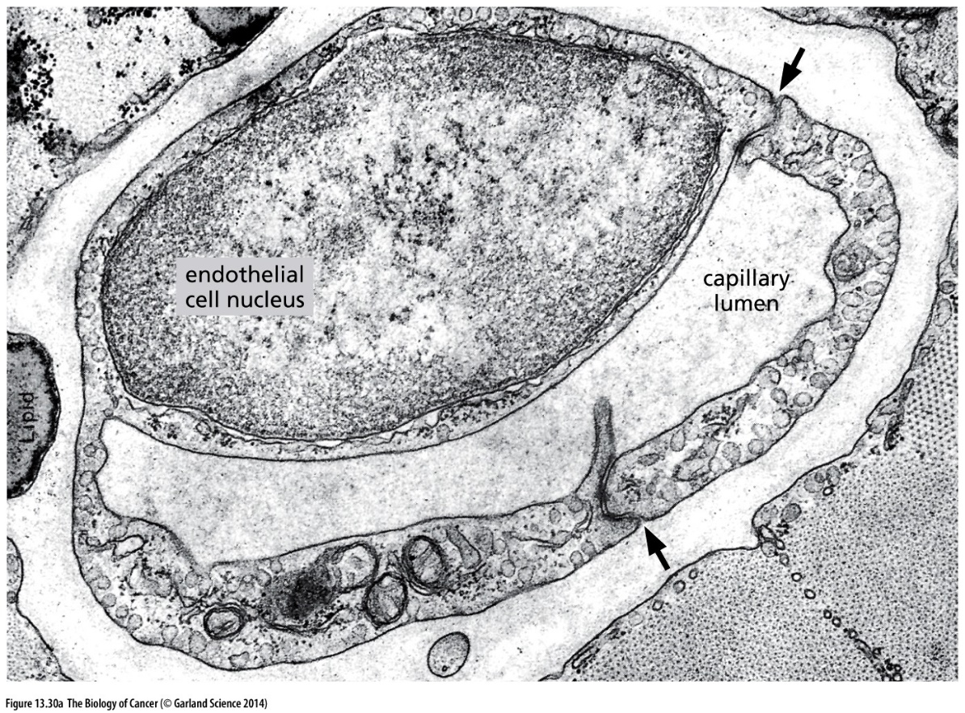
Figure 13.30 Endothelial (内皮) cells and the formation of capillaries(毛细血管)
(A) This transmission electron micrograph reveals the cross section through a capillary in the midst of cardiac muscle and shows how the cytoplasms of two endothelial cells have become joined (arrows) to form the lumen of a capillary. The nucleus of one of the endothelial cells is also seen here.

Slide 49
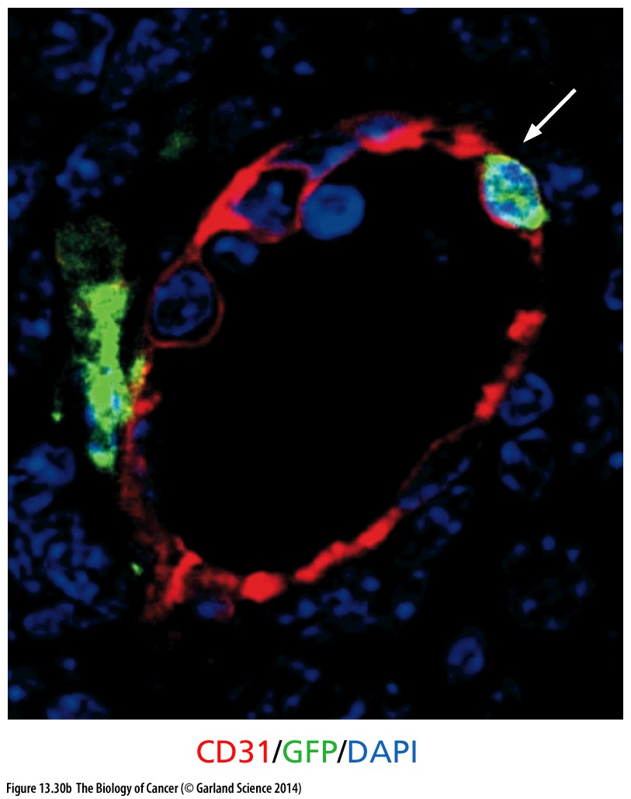
Figure 13.30 Endothelial cells and the formation of capillaries
(B) Early in the formation of many tumors, the bulk of the endothelial cells derive from endothelial progenitor cells (EPCs) that are acquired via the circulation from the bone marrow and differentiate within the tumor stroma. The endothelial cell is indicated by the CD31 endothelial-specific marker (red).

Slide 50
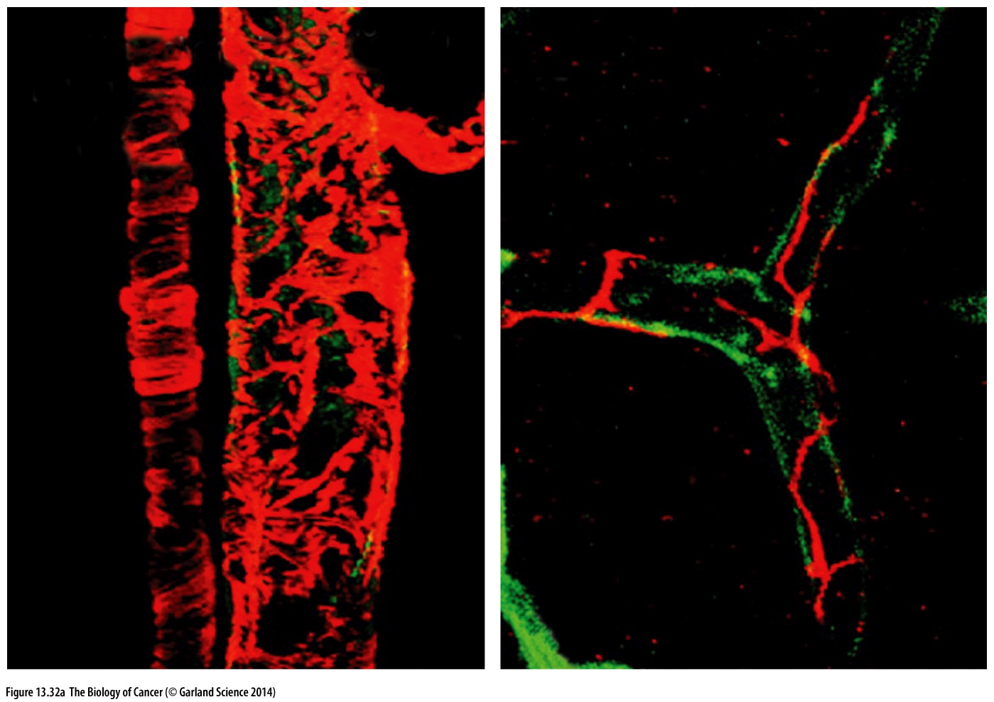
Figure 13.32 Pericytes(壁细胞)in normal and tumor-associated vessels
Venules(小静脉) capillaries(毛细血管)
(A) This immunofluorescence micrograph shows that pericytes and smooth muscle cells (both red orange) coat the outside of the tubes of endothelial cells (green), forming normally structured venules and arterioles (left panel). Pericytes and smooth muscle cells often cover these vessels so completely that it is difficult to see the underlying endothelial cells. In contrast, in capillaries (right panel), the pericytes are more sparsely disposed, but are nonetheless tightly attached to the endothelial cells.

Slide 51
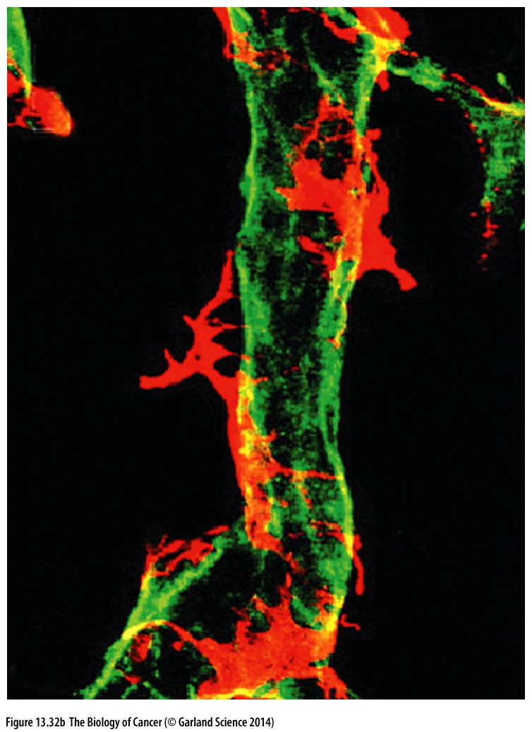
Figure 13.32 Pericytes in normal and tumor-associated vessels
(B) This micrograph reveals the structure of a tumor-associated microvessel. The endothelial cells forming the lumen of this vessel (green) are only partially overlain by pericytes and smooth muscle cells (red orange). The loose attachment of pericytes to the capillaries can be contrasted to their tight attachment seen in Figure 13.7A and B and panel A of this figure.
总结肿瘤血管特点：
Normal microvessel vs Tumor microvessel
Non-leaky
leaky
Enough pericytes
Less pericytes
Well organized
disorganized
Notes:
这解释了为什么肿瘤中的血管is leaky, 这个特征可用于临床特异杀死肿瘤组织

Slide 52
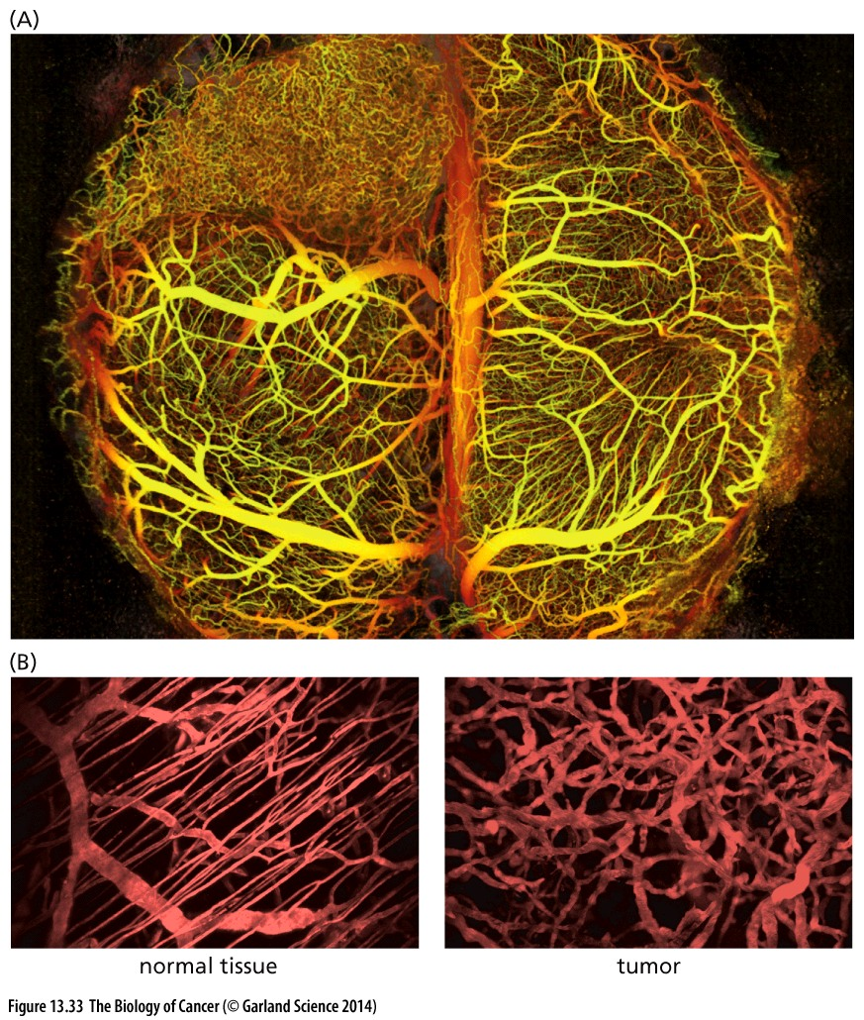
Figure 13.33 The chaotic organization of tumor-associated vasculature
(A) Intra-vital multiphoton microscopy allows the imaging of living tissues at multiple depths, in this case, the microvasculature of an implanted human glioblastoma multiforme growing as a xenograft in the mouse brain (upper left). Note the absence of the well organized hierarchy of major and minor vessels that is apparent in normal brain tissue. (B) Two-photon microscopy has generated this higher-resolution image of the detailed organization of normal vs. neoplastic microvessels. Note the differing overall organization of the microvascular beds in the normal vs. tumor tissue as well as the increased diameters of the tumor-associated capillaries.
Normal vasculature: well-organized;
Tumor vasculature: chaotic (混沌的).
Notes:
肉眼可见tumor血管系统与正常的完全不一样

Slide 53
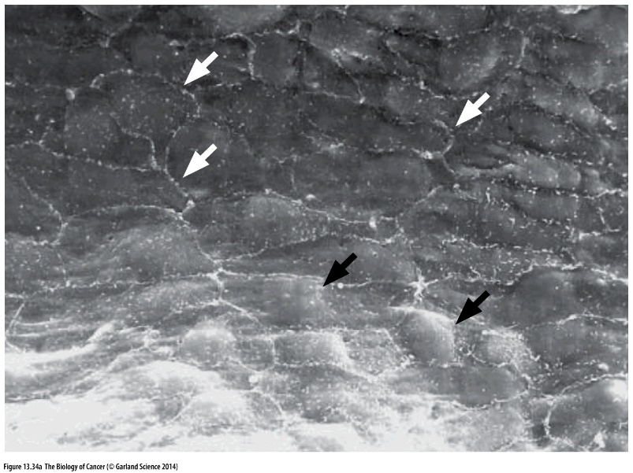
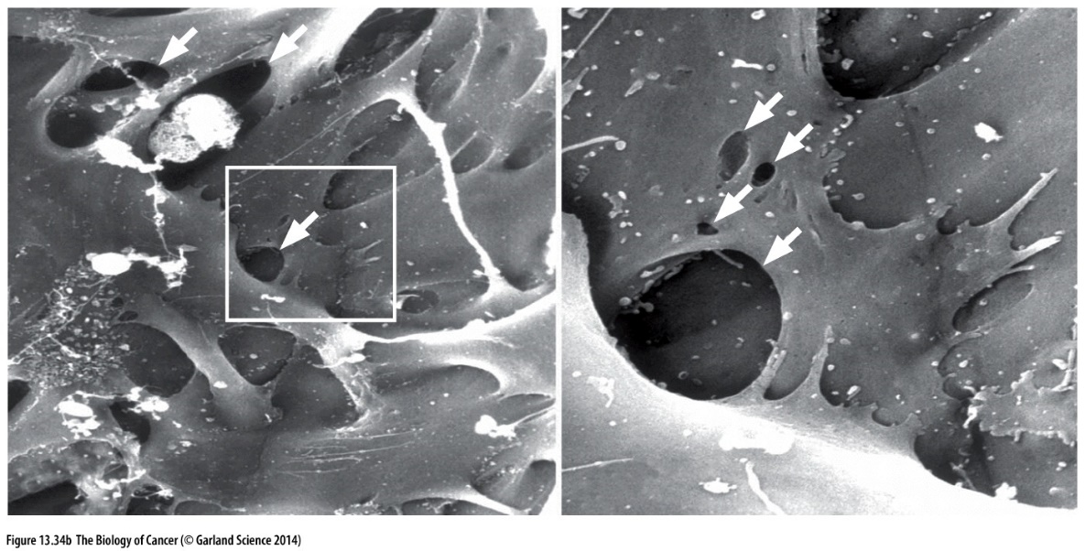
Figure 13.34 Gaps in the tumor microvasculature and resulting leakage
Normal microvasculature Tumor microvasculature
Scanning electron micrograph

Slide 54
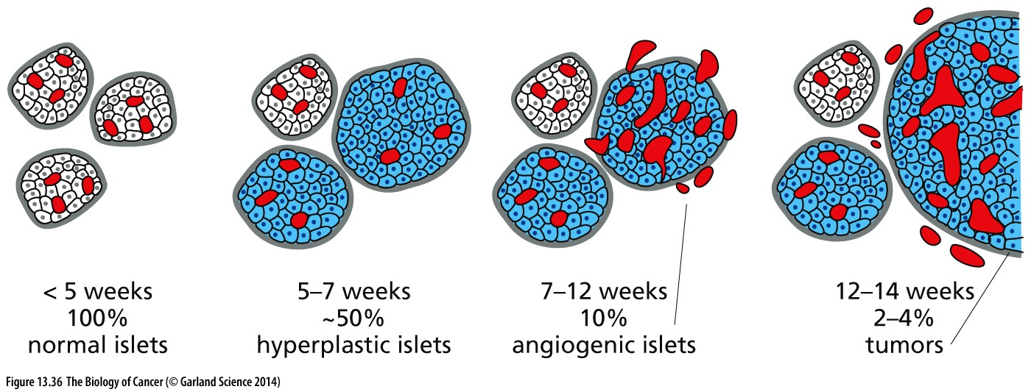
Figure 13.36 The Rip-Tag model of islet cell tumor progression
the Rip-Tag transgenic mouse. It carries a transgene in its germ line, in which the expression of the SV40 large T antigen (see Sections 8.5 and 9.1) and small T antigen (see Sidebar 11.5) is driven by the promoter of the insulin gene. This promoter ensures expression of these viral oncoproteins in the β cells that form the islets of Langerhans in the pancreas (in which insulin is normally produced).
Notes:
仅供参考

Slide 55
Angiogenic switch
At some point in time, however, small clusters of these pre-neoplastic islet cells suddenly acquire the ability to provoke neoangiogenesis (see Figure 13.36). Once these cells learn how to induce capillaries to form nearby, they and their descendants seem to be liberated from the major constraint that has been holding back their multiplication. This sudden, dramatic change in the behavior of the small tumor masses has been termed the “angiogenic switch.”

Slide 56
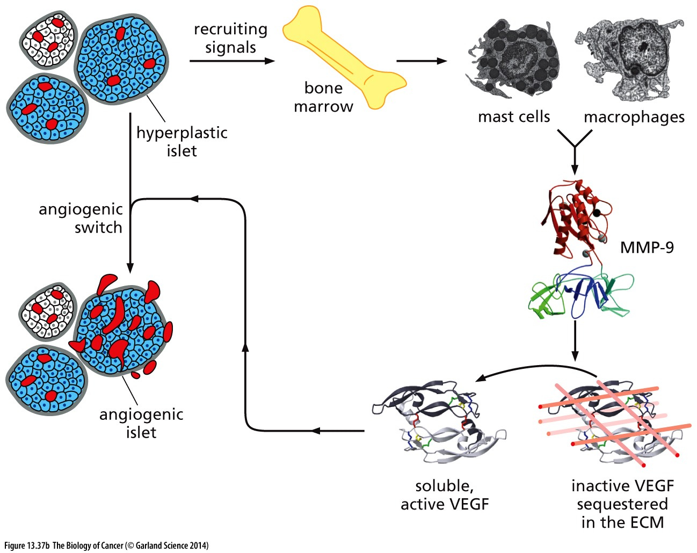
Figure 13.37 The angiogenic switch and recruitment of inflammatory cells
(B) According to the scheme presented here, a pre-angiogenic, hyperplastic islet sends signals to the bone marrow that lead to the recruitment of mast cells and macrophages. Once in the vicinity of the islet, these release metalloproteinases （金属蛋白酶）, notably MMP-9. MMP-9 then cleaves extracellular matrix (ECM) components, liberating vascular endothelial growth factor (VEGF) from its sequestered state. VEGF proceeds to induce angiogenesis around the islet, thereby tripping the angiogenic switch.

Slide 57
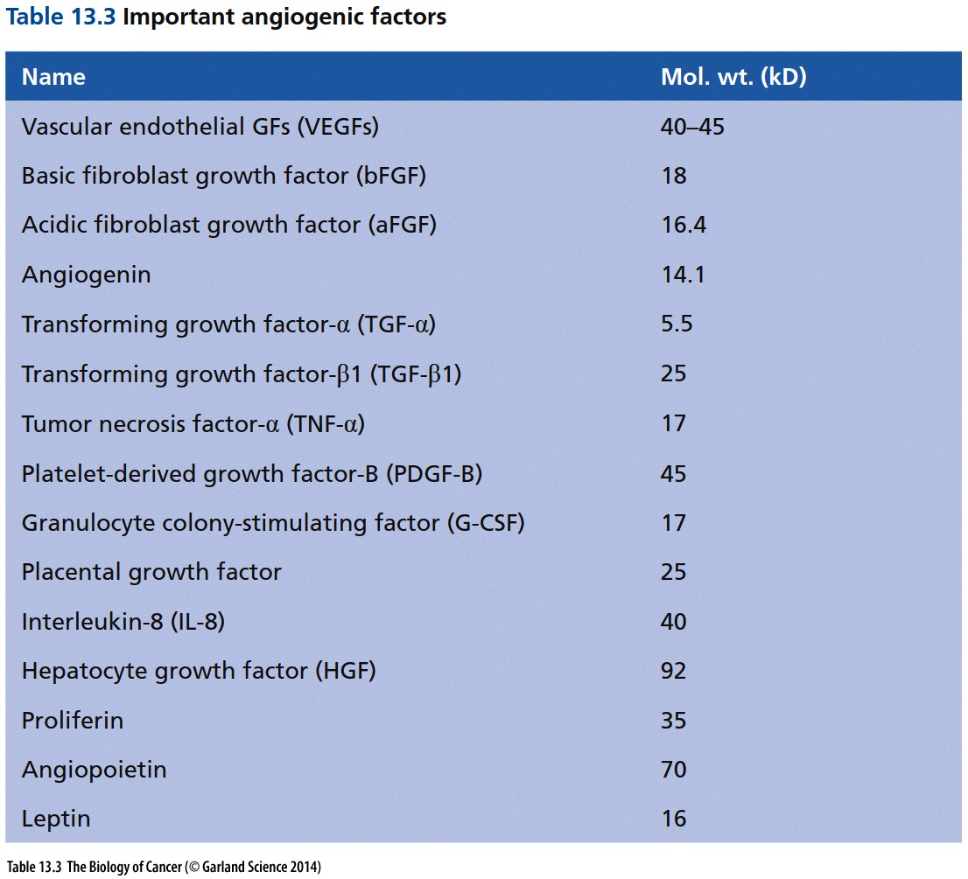

Slide 58
13.8 The angiogenic switch initiates a highly complex process
13.9 Angiogenesis is normally suppressed by physiologic inhibitors

Slide 59
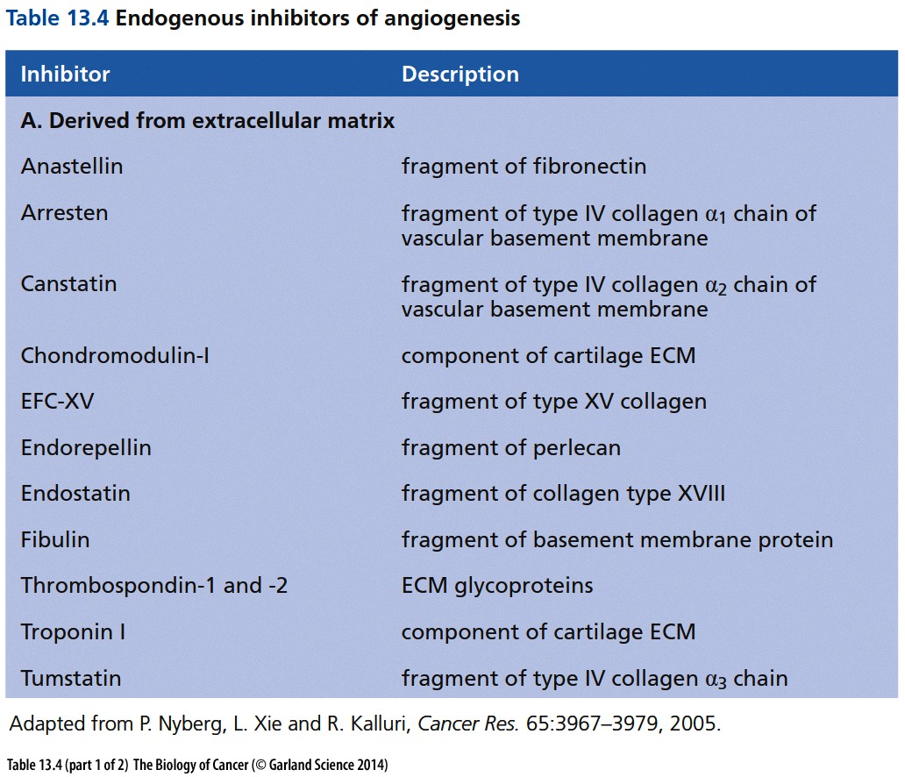

Slide 60
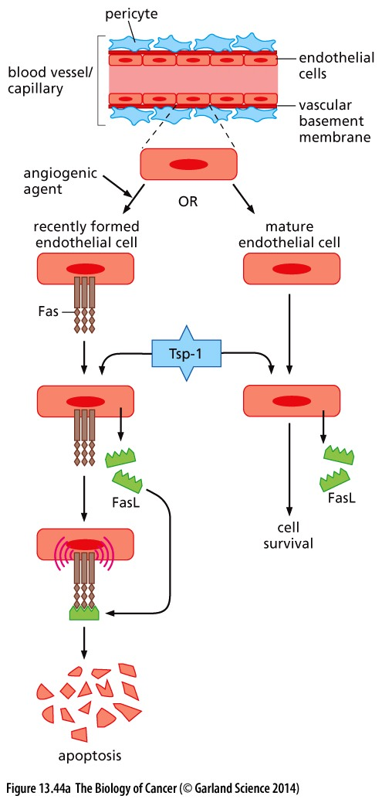
Figure 13.44 Thrombospondin, endothelial cell survival, and tumorigenesis
(A) The stimulation of resting endothelial cells with angiogenic agents, such as VEGF or bFGF, creates activated, growing endothelial cells (left branch), which soon express the Fas death receptor on their surface. Subsequent treatment of mature and recently formed endothelial cells with thrombospondin-1 (Tsp-1; blue) causes both groups of cells to secrete FasL (green), the ligand of Fas. However, because only the activated endothelial cell displays the Fas receptor, it is preferentially induced to enter into apoptosis by Tsp-1, while the FasL secreted by the mature, resting endothelial cell cannot be induced to enter apoptosis because it cannot bind and respond to secreted FasL. This seems to explain why Tsp-1 can block new angiogenesis but has relatively minimal effects on already constructed vasculature, whose endothelial cells are only rarely involved in active proliferation.

Slide 61
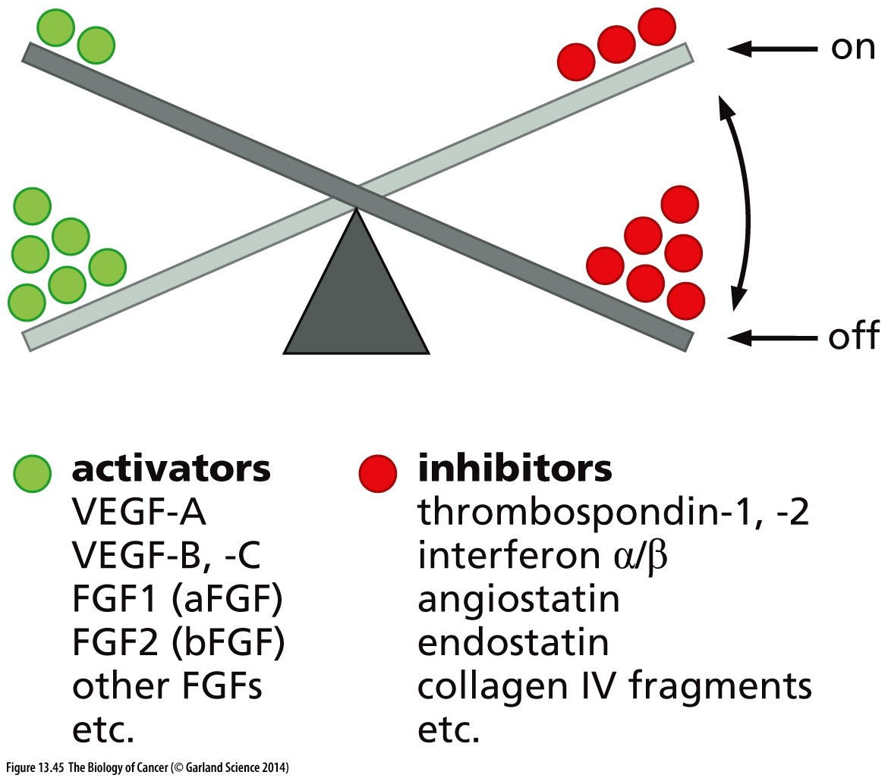
Figure 13.45 Balancing the angiogenic switch

Slide 62
13.10 Anti-angiogenesis therapies can be employed to treat cancer
CD20
Bevacizumab is a mAb against VEGF
EGFR
proteasome inhibitor
EGFR

Slide 63
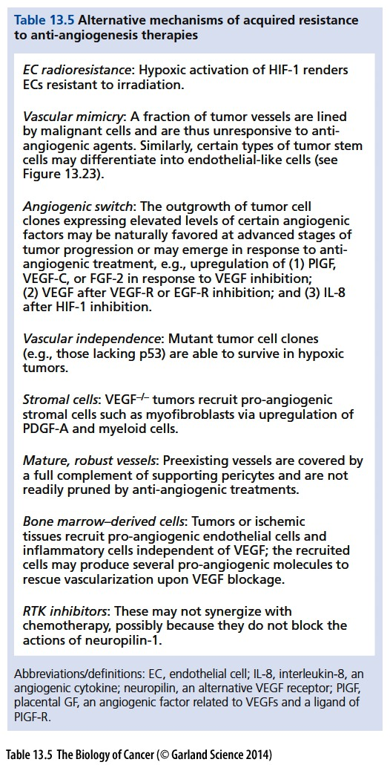

Slide 64


Slide 65


Slide 66

Anti-angiogenesis combined with anti-pericytes in cancer therapy

Slide 67

Figure 13.47 Survival of wild-type and asmase-negative tumor-bearing mice
The responses of tumors to radiotherapy may often be determined by the radiosensitivity of the endothelial cells that form their vasculature. Mice were bred to be either wild type or homozygous null for the gene encoding the pro-apoptotic enzyme acid sphingomyelinase (asmase). When mouse fibrosarcoma cells were implanted in the mice, the tumors grew twice as fast in the asmase–/– mice as in the wildtype mice, suggesting that a host factor, such as recruited endothelial cells, was governing the rate of tumor growth.
Asmase is highly expressed in endothelial cells, is pro-apoptotic regulator for endothelial under stress, like radiation
Notes:
仅供参考，stromal cell 调控肿瘤细胞的又一个证据

Slide 68

Figure 13.48 Undesired effects of inhibiting angiogenesis
By depriving tumors of their microvasculature through anti-angiogenic therapies, sectors of such tumors rapidly develop hypoxia. The effects of this hypoxia may be complex, sometimes leads to increased tumor aggressiveness.

Slide 69

Figure 13.49 Heterotypic interactions as targets for therapeutic intervention
As described in this chapter, cancer cells are dependent on the nearby stromal microenvironment for a variety of cell-physiologic supports. Instead of focusing on the intracellular signaling defects within cancer cells, this new type of therapy is directed toward interrupting heterotypic signaling, thereby depriving cancer cells of essential stromal support.
Notes:
stromal cell也可以是癌症治疗的靶点

Slide 70
课后作业
1, Describe the function of tumor associated stromal cells
2, Why it is difficult to generate cancer cell lines from cancer tissues? Why cancer cell line could not precisely represent original tumor?
3, Describe the difference between tumor and normal vasculature.

